Slide 1
How and When to Implement AAC
An Overview of Important Strategies and Tools
Notes:
preschoolers learn 860 new words a year-- WOW!
Understanding symbols carry meaning is key for developing language and literacy skills.
toddlers, playing with language and getting reenforcement from adults (laughing, talking with them ,repeating, more language play)
new syntax, asking questions, making statements, negating
shift the narrative from it “being an extra thing to track” to being a tool that you can use to improve learning for a range of people you may encounter.

Slide 2
Things to remember as you begin…
Knowing how child is currently communicating is key to identifying their skills and areas of need.
Remember that AAC supports receptive (input) and expressive (output) language development
AAC provides support for individuals who need alternative access to language input and processing

Slide 3
Things to remember as you begin…
AAC is a tool that can foster the development receptive language skills, as well as expressive language
At first children are learning to communicate and eventually shift to communicating to learn…
The skills of understanding symbols carry meaning are key for developing language and literacy skills.

Slide 4
More Shared Context and Definitions
All solutions represented on the AAC continuum can offer access to:
Core Vocabulary—general language used across multiple environments
Examples: more, go, all done, here, help, want, mine
Fringe Vocabulary—language that is specific to a certain activity/environment
Examples: blueberries, mask, coco melon, crayon, field trip specific vocab

Slide 5
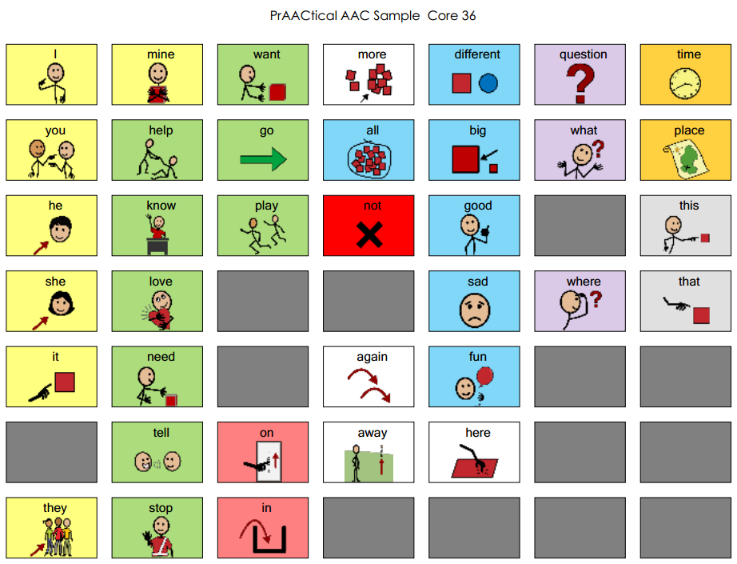
2-Minute Challenge (Activity)
Core vocabulary
Notes:
START WITH: 2-minute challenge; how many 2-word phrases can you create with these sample core words?
Studies show that various methods for implementing aided language input result in increased aided language output from the AAC learner.
Core “words of the week” for emergent communicators
Semantics: What words do typically developing children use?
Pragmatics: Why do typically developing children use those words? What are their
reasons for using them?
Syntax: What word combinations do typically developing children make?
Morphology: What endings do typically developing children put on words?
Core vocabulary are those words used with high frequency and make up about 75-80% of the words we use everyday. Core vocabulary should be a main part of all AAC systems because it allows for most flexibility across most situations.

Slide 6
Vocabulary (what does the child want to say?)
Core
Fringe
High frequency words that are functional across tasks and environments
Most predictable
Low frequency are fringe vocabulary words that are functional in highly specific contexts only
Most personal and motivating!
Gives power of specificity

Slide 7
Core + Fringe Vocabulary
A Matrix Tool for building vocab (from Nigam, Schlosser & Lloyd, 2006)
Teach and add symbols as you go!
Action | Object
 | Car | Bike | Truck
Go
Stop
Put in

Slide 8
Core + Fringe Vocabulary
Incorporate phrases that encourage interaction
I want
Something’s wrong
I’ll tell you what I think
It’s time…
I’m telling you a story

Slide 9
More Shared Context and Definitions
Aided Language Modeling –modeling use of external symbols to communicate
Not only provides model but slows our rate of speech and highlights key words to attend to, making processing easier.
Coach peers + partners to use more communication modalities.
A strategy for students at ANY level of communicative ability.

Slide 10
Aided Language Modeling
Does not mean:
You have point to every word you are saying.
That you need two communication devices
That you require the child to repeat what you’ve modeled
Instead, you are verbally saying a short, complete sentence as you model key words for the child.
Creates natural opportunities for practice communicating

Slide 11
Scripting Strategies for Communication Modeling and Practice
Some vocabulary can be predictable
Basic needs, social etiquette, current events, routine activities
Examples:
Activity #1 – Use of VSD for self-guided activities (homework, chores)
Activity #2 – Family game night
Activity #3 – Going to the grocery store/ Outdoor activities

Slide 12
Scripting as a Tool
For infusing daily routine and recreation with AAC
Everyday events and routines provide scripts
Help individual anticipate upcoming events
Examples:
BINGO
Follow the leader
Board games
Card games
Duck, duck, goose
Picnic / Cook out
Trip to the Beach

Slide 13
A note about Symbols
Not all symbols will be meaningful, guessable or transparent by the child and/or his/her partners.
Consider the child’s receptive (understanding) skills when selecting symbolic language for modeling and scripting.
Actual object is more recognizable than 3-D objects, which are more recognizable than pictures, which are more recognizable than line drawings, which are more recognizable than letters of the alphabet.
It is okay to mix different types of symbols (e.g., picture + object)

Slide 14
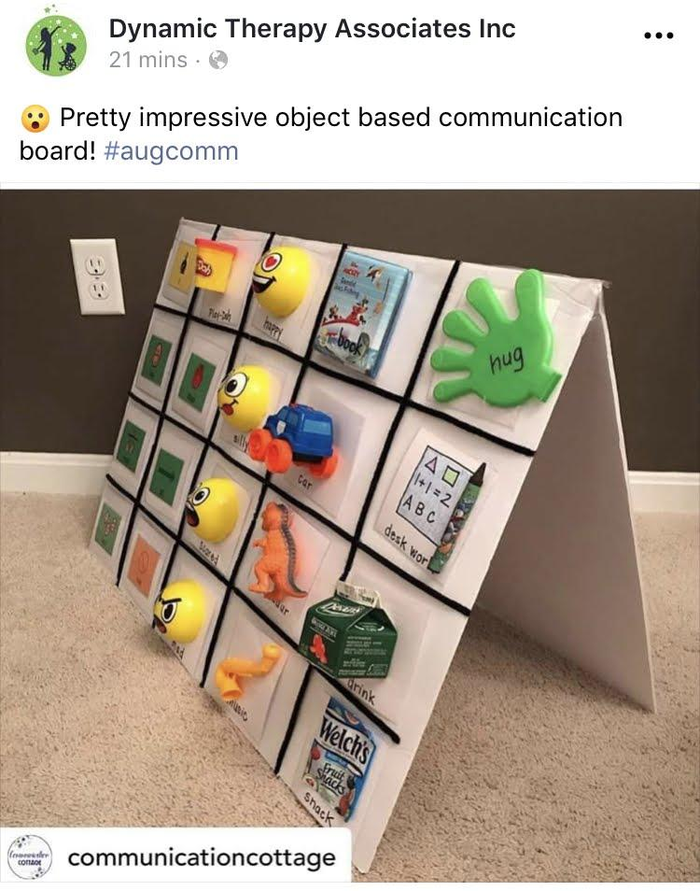
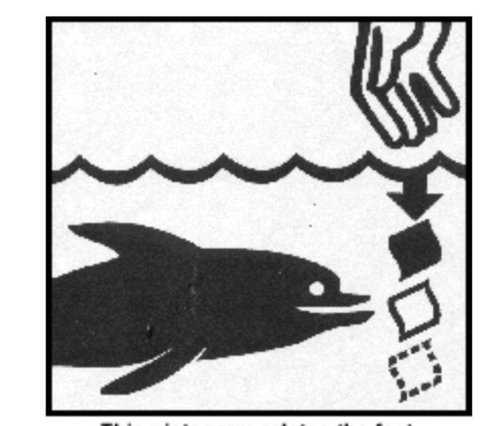
A Note on Symbol Transparency
Actual Object
3-D object replica
Color photo
B & W photo
Color Line drawing
B&W Line drawing
Letters
More Transparent
(guessable, rememberable, recognizable)
Less Transparent
Notes:
This pictogram indicates an item will biodegrade into an ocean
Each point on the AAC continuum represents distinct symbolic language options.
It’s OK to MIX different symbol types
Use what is most memorable and meaningful

Slide 15
Disclaimer
This is a product of the Early Childhood Personnel Center (ECPC) awarded to the University of Connecticut Center for Excellence in Developmental Disabilities and was made possible by Cooperative Agreement #H325B170008 which is funded by the U.S. Department of Education, Office of Special Education Programs. However, those contents do not necessarily represent the policy of the Department of Education, and you should not assume endorsement by the Federal Government.

