Slide 1
Professionalism and Ethical Practice
Initial Practice-Based Professional Preparation Standards Early Interventionists/Early Childhood Special Educators
7.3

Slide 2
Standard 7
Candidates identify and engage with the profession of early intervention and early childhood special education (EI/ECSE) by exhibiting skills in reflective practice, advocacy, and leadership while adhering to ethical and legal guidelines. Evidence-based and recommended practices are promoted and used by candidates.

Slide 3
Component: 7.3
Candidates exhibit leadership skills in advocating for improved outcomes for young children, families, and the profession, including the promotion of and use of evidence-based practices and decision-making.
Notes:
Read the text aloud to the group

Slide 4
Objectives
Describe the role of leadership and advocacy to improve outcomes for young children, families, and the profession.
Describe the use of evidence-based practices and decision making to improve outcomes for young children, families, and the profession.
Notes:
Read the objectives aloud to the group

Slide 5
Know the System
Notes:
It is important for EI/ECSE professionals to have foundational knowledge of policy and advocacy to engage in advocacy and to support families in becoming advocates and engaging in leadership. As part of this foundational knowledge, it is important to understand systems for developing and amending policiesthat impact services for children and families at the local, state, and federal levels.

Slide 6
Definition of Public Policy
A decision or action of government that addresses problems and issues.
Notes:
Read the definition for policy. Before we discuss ways that you can become or continue to be an advocate and advocacy strategies, we will focus on public policy with an overview of policy processes and development at the federal, state, and local levels.

Slide 7
Advocacy Definitions
“The act or process of supporting a cause or proposal.” (Merriam-Webster)
Actions that recommend, argue for a cause, support or defend, or plead on behalf of others. (Alliance for Justice)
“…understanding and engaging in activities that inform the legislative process at the federal, state, or local level.” (Stegenga et al., 2020, p.4)
Notes:
By understanding how policies are developed and what policies exist at different levels, including within the program in which you currently or may work in the future, you will be better prepared to argue for and support policies that ensure quality services for young children and their families. This slide includes three definitions for advocacy.

Slide 8
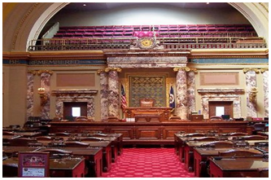
Policy Evolution
Federal
Statute
Regulations
Policy Letters
Court Decisions
State
Laws/Codes
Regulations
Policies
Procedures
Guidance
Hearing or Court Decisions
Local
County/City Rules
Provider Agency Policies and Procedures
School Board Policies and Procedures
Notes:
Advocacy and advocacy strategies as discussed in this set of power point slides applies to each of the levels below.
Federal Level - Statutes or legislation are laws that are passed by Congress. IDEA is an example of a federal statute. Regulations define what the law looks like in practice. For example, Part C regulations further describe what is meant by natural environments, identify the requirements for IFSP development and implementation, etc. For example, Part B 619 regulations further describe assessment/evaluation and eligibility requirements. Policy letters or statements provide a consensus statement about a specific topic or issue. As an example, the U.S. Department of Engagement and the Department of Health and Human Services recently published and disseminated a policy statement regarding inclusion. Court decisions may impact how statutes and regulation are interpreted or result in a need for new statutes or regulations or amending current ones. For example, in Endrew F. v. Douglas County School District, the U.S. Supreme Court ruled that for students with IEPs, schools have the responsibility to provide educational services that allow for more than minimal progress on IEP goals.
State Level – Statutes and regulations at the state level must meet the requirements of federal statute and regulation requirements, if there are relevant federal laws/regulations. For example, your state probably has a statute and regulations for the Part C program in your state that includes the federal requirements and then, adds additional requirements for the state. For example, some states require that those in the special instructor role must hold the same certification as preschool teachers in that state to provide those Part C services. States may also have policy, procedure, and/or guidance documents that provide more specific guidelines related to personnel and service delivery. These are typically developed by state level administrators for specific programs, sometimes with input from an advisory group. For example, your state’s Part C and Part B619 programs may have policies about required continuing education for providers. The state’s Part C Interagency Coordinating Council (ICC) may have made recommendations as to what the policy should say about continuing education.
Each state operates under a different law-making process; however, many commonalities exist among states. Forty-nine states have bicameral, or 2 chamber legislatures. The “upper” chamber is commonly known as the Senate and the “lower” chamber is known as the house of representatives or the assembly. The exception is Nebraska, which is unicameral, or 1 house. Legislative sessions vary from state to state and year to year. The governor is the chief executive of a state and is responsible for the administration of the government.
Local level – At the local level, the agency/entity that administers a specific early childhood program (e.g., Part C, Head Start, public school preschool) may also develop policies and procedures that provide specific guidelines for implementing state statutes and regulations. For example, local policies and procedures may identify a specific form for IFSPs and IEPs, as well as who within the agency can chair those meetings.

Slide 9
Who Are the Policy Makers?
Federal
U.S. Congress
Representatives
Senators
Agencies (e.g.,)
U.S. Dept. of Ed
Dept. of Health &
Human Services
State
Legislators
State agencies (e.g.,)
Education
Part C Lead
State Board of Education
Local
School Board
Part C Agency Head Start
Childcare
Private Schools
Notes:
These are some of the main policy makers/elected officials that you may be interacting with as you advocate for a specific policy, concern, etc. At the federal level, it is important to know who your representatives and senators are, and to also know who your state legislators are. Slide 9 provides a link that will assist you in identifying your elected officials at the local, state and federal levels.

Slide 10
Video: The Legislative Process: Overview
Watch the video “The Legislative Process: Overview” on the next slide before breaking into small groups;
In your small group:
identify who the Federal Representatives and Senators are for your state, your region of the state,
determine their committee assignments, and
find out if any of them are in committee leadership roles.
Use the following website to access this information: U.S. Government.
Notes:
Introduce the video as follows. This video provides an overview of the legislative process at the federal level. The overview includes a brief discussion of the legislative branch, including information about the House of Representatives and the Senate, roles of each, and the committee structure.
A transcript of the video is provided at the link in the slide.
For additional information and/or to provide more in-depth information about the federal legislative process for learners, there are eight additional videos with transcripts at this link https://www.congress.gov/legislative-process.
https://www.usa.gov/elected-officials
https://youtu.be/E1CIWwu6KdQ

Slide 11
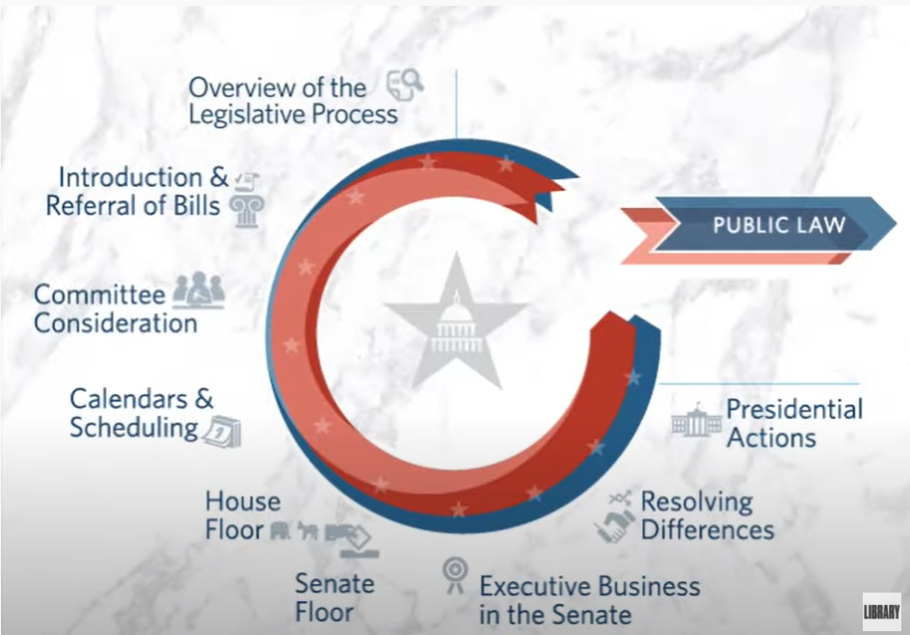
Video: Overview of the Legislative Process
https://youtu.be/E1CIWwu6KdQ
Notes:
https://youtu.be/E1CIWwu6KdQ

Slide 12
Phases of the Public Policy Life Cycle
Definition of the Problem
Agenda Setting
Policy Adoption
Implementation
Evaluation
The life cycle is only a framework – not all policy is formed according to this linear model. However, all policy creation is incremental and builds upon prior developments and activities.
Notes:
Definition of the Problem - A problem is identified and examined, and possible solutions are explored through research and analysis. For example, the problem might be lack of full funding for Part C and Part B 619. Results of cost analysis studies would inform what the per child funding should be to reach full funding. Or maybe a problem in the community in which you live is that there is no interagency agreement regarding transition services.
Agenda setting - Efforts used to raise the profile of the problem and possible solutions among the public and decision makers.
Agenda setting strategies may include:
Community organizing
Public education
Media and communications
Convening stakeholders
Building coalitions
Policy adoption - Discussion of options and possible solutions, which leads to either adopting a new policy or amending existing policy.
Common strategies used to impact policy adoption include:
Issue advocacy
Regulatory advocacy
Community organizing
Public/private partnership creation
Implementation - Implementation is an essential phase during which critical decisions are made which ultimately determine the policy’s effectiveness
Approaches used include:
Issue advocacy
Regulatory advocacy
Litigation
Public/private partnership creation
Evaluation - Policy research and analysis are strategies to evaluate whether the policy meets its original intents and if there are any unintended outcomes. If the policy is not successful on any level, evaluation findings can be used during a new phase of problem definition. The policy life cycle begins again and continues until an effective policy is created and successfully implemented.

Slide 13
Ways to Engage in Advocacy
Understand the legislative process
Join professional associations
Stay informed about issues
Vote for federal, state, and local officials
Know your elected officials and communicate with them
Identify and use advocacy resources
Notes:
https://www.congress.gov/help/learn-about-the-legislative-process
https://www2.ed.gov/policy/landing.jhtml
https://www.vote.org/
https://www.usa.gov/agencies
As addressed in previous slides, it is important to understand the legislative/policy process when preparing to advocate for a particular issue whether that be at the national, state, or local level. The link included in the slide is for a congress.gov page that identifies multiple resources to learn about the legislative process at the national level.
It is also important to be a member of one or more professional association, such as the Division for Early Childhood (DEC) and the Council for Exceptional Children (CEC). Both DEC and CEC, as part of their missions, advocate on behalf of the profession, their members, and children and families. Both associations have a policy and advocacy section on their websites (the links to these pages are in the resources slide) with current issues, advocacy resources, and interactive ways to contact your legislators.
In addition to professional association websites, the U.S. Department of Education has a website that provides information about local, state, and national issues that impact EI/ECSE.
Registering to vote and voting for candidates whose policies are consistent with your values and priorities for EI/ECSE at the local, state, and national levels has great implications for the profession and services for children and families. The link in the slide is for vote.org which provides you with information needed to vote in state election centers.
The next slides will identify some of the different ways in which you may communicate with elected officials, strategies for using each communication type, and resources to assist you in that communication.

Slide 14
Identifying an Issue and Identifying With Whom to Communicate
Using the links below, identify an issue at the state or national level that is of concern to you:
U.S. Department of Education Laws & Guidance
Discuss the importance of the issue to EI/ECSE
Using the links below, identify the policy makers with whom you will communicate about the issue:
CEC Legislative Action Center
Government Agencies and Elected Officials
Notes:
https://www2.ed.gov/policy/landing.jhtml
Legislative Action Center | Council for Exceptional Children https://exceptionalchildren.org/takeaction
https://www.usa.gov/agencies
Either individually or as a small group, practice using some of the websites that are intended to be resources to advocates. Both the U.S. Department of Education Laws and Guidance and the CEC Legislative Action Center will help you identify state and/or national issues of concern to EI/ECSE. The latter website, as well as the USA Gov, Government Agencies and Elected Officials site allow you to identify your local, state, and national policy makers with whom you will want to communicate about the identified issue.

Slide 15
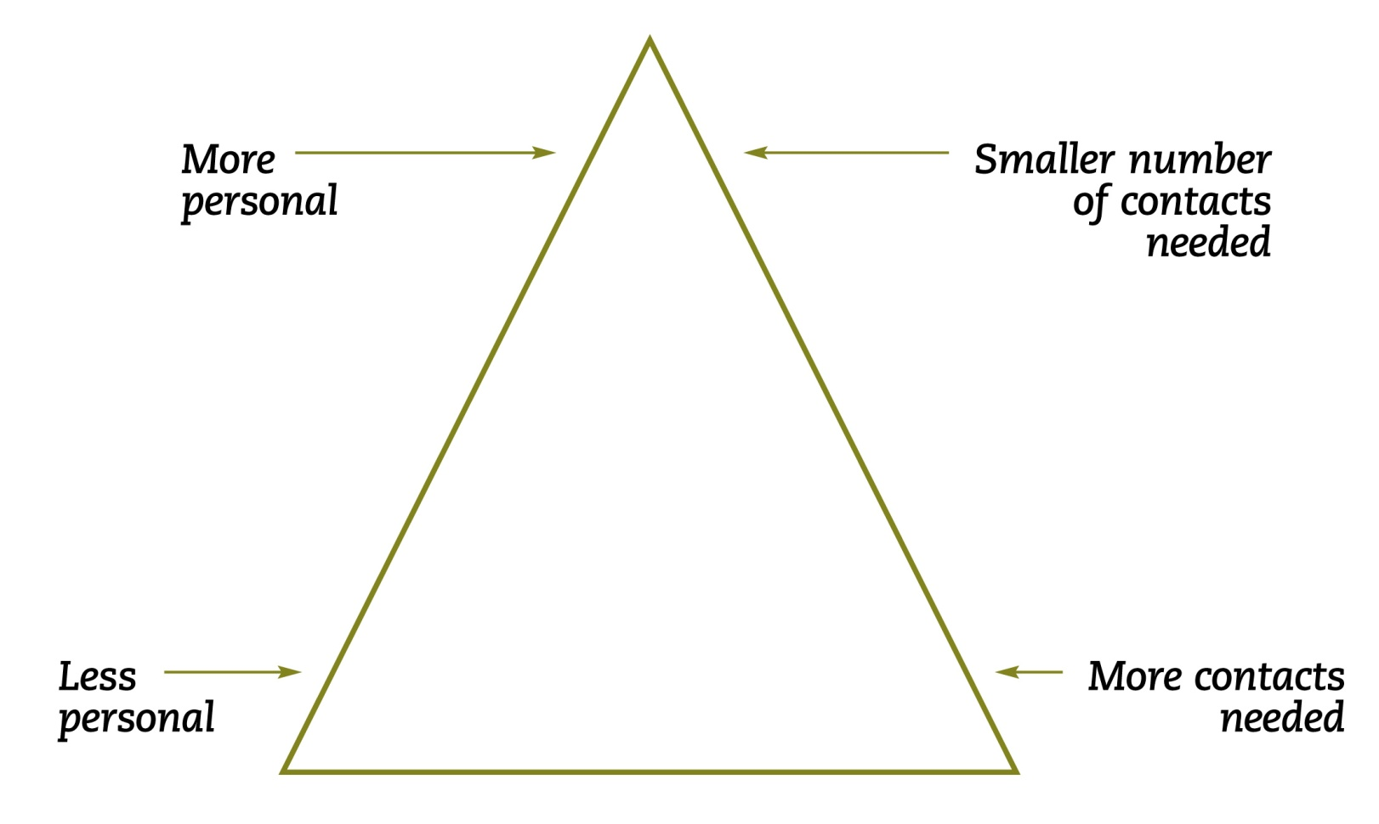
The Contact Pyramid
American Academy of Pediatrics (AAP). (n.d.). Advocacy Training Module 3: Working with Decision-Makers. AAP.
American Academy of Pediatrics (AAP). (n.d.). Advocacy Training Module 3: Working with Decision-Makers. AAP.
Notes:
When choosing how you will contact/communicate (e.g., letters, emails, meetings, phone calls) with a decision-maker or elected official at the local, state, or national level consider:
The degree to which the activity is personal, and
The number of times that you would need to communicate with that individual and/or the number of times that you may need to communicate with more than one person.
When choosing how you want to communicate, keep in mind that the more personal you can make your communication, the better. For example, while maintaining confidentiality, you might share some actual stories about your work in EI/ECSE.

Slide 16
Ways to Communicate
Phone calls
Writing letters
Sending emails
Meetings
Notes:
As an advocate, there are many ways that you might communicate your message with decision-makers, elected officials, and/or other individuals who have influence specific to the issue or problem.
Four of the common communication strategies are phone calls, writing letters, sending emails, and meeting with the individuals. For each of these, we will identify some of the things that have proven to be most effective for that particular communication strategy, as well as some of the resources available to you specific to that strategy.

Slide 17
Phone Calls
Plan before making the call
Identify the key point(s) of
your message
Make the call
Prepare to talk to a staff
person or leave a message
Notes:
Plan – Before making the phone call, think about what you will say. Remember to keep the message brief and simple.
Your Message – Identify the key 1-2 points that you want to make and any specific example or story that will support that message. If you are calling about an issue that has “two sides”, be sure that your key point(s) and any examples clearly articulate your position regarding the issue. You may want to practice what you will say prior to making the call.
Make the Call – When you have reached the person who you are calling or a “message center”, state your name, identify yourself as a constituent of that legislative district or community, and state the role that you are representing during this phone call (e.g., early interventionist, preschool teacher, administrator, family member). Share your message.
Talk with a Staff Person or “Message Center” – You may reach a staff person instead of the person who you are attempting to phone, or you may be asked to leave a message. Share your message in the same manner as above, including your key point(s). Part of the staff role is typically to educate and persuade the individual for whom they work.

Slide 18
Writing Letters
Identify who you are
Personalize the letter
Emphasize a local connection
Keep it brief
Notes:
Identify Who You Are - Identify yourself as a constituent of that legislative district or community and state the role that you are representing as the letter writer (e.g., early interventionist, preschool teacher, administrator, family member).
Personalize the Letter – Research indicates that personal letters have the most impact. Therefore, it is important to include any specific real-life examples and stories to support your point(s). If you are using a template and/or a form letter such as those that CEC includes on their website for specific policy issues, add a personal statement in addition to the statement that is already in the letter. Or better yet, rewrite the letter on your personal stationery or letterhead.
Emphasize a Local Connection – Make connections as to how the issue/problem is evident in your own community and how early intervention and early childhood special education services, children, and families are being impacted.
Keep it Brief – Your letter should be no more than 1 to 1 ½ pages in length. As with phone calls, Identify the key 1-2 points that you want to make and any specific example or story that will support that message. If you are writing about an issue that has “two sides”, be sure that your key point(s) and any examples clearly articulate your position regarding the issue. End the letter on a positive note and thank the recipient for the opportunity to communicate with them. And state that you would be willing to provide additional information and communicate further about the matter, including an email address and/or phone number.

Slide 19
Advocacy Letter for Legislation: What to Include
Salutation – Dear Senator/Representative______
Opening paragraph – subject of letter, bill number/name, information about the writer
Body of letter
Simple, factual explanation of issue
Local example of implications
Support or opposition of the bill
Offer to provide more information
Reply requested
Notes:
Advocacy letters are somewhat different types of letters in that they are written in support or opposition of a particular piece of legislation and provide information and examples to support or oppose that legislation. The letter is written in a positive, non-threatening manner and thank the recipient for attending to the issue. The writer offers to provide more information about the issue and their stance on the legislation, as well as requests a reply from the recipient. Therefore, the writer’s contact information is provided, typically email and phone number.

Slide 20
Sample Advocacy Letters
Open the two URL links below:
Read the form letter on the CEC website
Read 1-2 of the advocacy letters on the DEC website
Revise the message body of the form letter and submit based on review of the sample letters and “what to include” tips on the previous slide
CEC Legislative Action Center – form letters
DEC Policy and Advocacy – sample advocacy letters
Notes:
The “message body” of the letter should be drafted individually. The letter could then be reviewed by a peer for clarity and relevance of content and adherence to writing conventions prior to it being submitted.
https://exceptionalchildren.org/takeaction
https://www.dec-sped.org/

Slide 21
Sending Emails
Identify yourself in the subject line
Personalize the content
Follow-up by phone, letter, or meeting
Notes:
Identify yourself in the subject line – Your email is more likely to be read if you identify yourself as a constituent and/or community member of the recipient and also identify the role that you are representing in sending the email (e.g., family member, preschool teacher).
Personalize the content – Include your personal story and perspective. If you have received an email message from a group that could be copied and pasted into a new email, revise it to be more credible.
Follow-up – Email is a more casual means of communication and many individuals’ inboxes are extremely full, so to ensure that your message is received follow-up using some other form of communication.

Slide 22
Scheduled Meetings
Before the meeting – plan
During the meeting – allow for discussion, share information visually
After the meeting – follow-up
Notes:
A planned meeting with your elected official/policy maker is typically a more personal way to interact and convey your message than other forms of communication.
Before the meeting – Plan what you intend to succinctly say including:
the issue or bill that you want to discuss,
your interest in this issue, why you care,
the impact on other people in the official’s constituency area, and
an “ask”, what do you want him/her to do.
During the meeting – Allow time for discussion, questions, and sharing any printed or other information. If you don’t know the answer to a question, say so, and volunteer to follow-up and provide an answer to the question. You may also want to leave a 1–2-page fact sheet or FAQs about the issue. Often, parents or family members may share a photo that represents something related to the issue and/or its impact on the family. Keep the meeting positive and non-confrontational.
After the meeting – As the meeting ends, thank the official for their time and let them know how they can follow-up with you with questions. Have a business card, etc. ready with your contact information. Send a follow-up thank-you by e-mail or a brief note.

Slide 23
Impromptu Meetings: Elevator Pitch
Brief summary of an issue/problem delivered in 30 seconds to 2 minutes
Planned “speech” for impromptu delivery
Goal – to pique the interest of the listener and lead to a follow-up meeting
Notes:
Impromptu, unplanned opportunities may arise to speak to an elected official/policy maker. When this occurs, it is important to have a pre-prepared brief message. Since you will likely have no more than 2 minutes to get your message across, you will want to identify the issue or policy, your key point, and possibly implications succinctly and without jargon. It is okay to be passionate as you want to get the interest of the listener. End the “speech” with a request to talk further, ask for a business card, and provide yours.

Slide 24
Elevator Pitch
Prepare with your group a two-minute elevator pitch to the President of the U.S. asking for full funding of IDEA.
Have someone role-play the President and someone from each group delivers the elevator pitch.
Notes:
After the elevator pitches have been given, discuss them as a group. You might ask students questions such as:
Which elevator speech seemed most persuasive to you? What are some of the characteristics of that elevator pitch that caused you to consider it most persuasive.
Ask the President which elevator pitch that he/she would be most likely to want to follow-up with more communication with the speaker.
Identify 1-2 of the other elevator pitches and ask what could have been said differently? Included? Eliminated from the pitch?

Slide 25
Advocating for Evidence-Based Practices
Notes:
As EI/ECSE professionals, an important aspect of our professional ethics and advocacy role is to seek, use, and advocate for evidence-based information to guide our practices. This is emphasized in both DEC’s code of ethics and in its recommended practices.
One of the four areas in the DEC Code of Ethics is Professional Practice which has six more specific principles and guidelines for practice. Two of the six are specific to evidence-based practices and advocacy for those practices.
One of the DEC leadership recommended practices is also relevant:
“L5. Leaders advocate for policies and resources that promote the implementation of the … DEC Recommended Practices.” (DEC 2014, p.5).

Slide 26
Evidence-Based Practices (EBPs): Definition (DEC, 2014)
“…the most effective ways to improve the learning outcomes and promote the development of young children, birth through five years, who have or are at-risk for developmental delays or disabilities. …..”based on the best empirical evidence as well as the wisdom and experience of the field.” (p.2).
Note: DEC uses the term recommended practices.
Notes:
Two sample definitions for evidence-based practices are provided on this and the next slide. DEC uses the term, recommended practices. The DEC recommended practices are organized into eight content areas:
Leadership,
Assessment,
Environment,
Family,
Instruction,
Interaction,
Teaming and collaboration, and
Transition.

Slide 27
Evidence-Based Practices (EBPs): Definition (ECTA)
“…the process that pulls together the best available research, knowledge from professional experts, and data and input from children and their caregivers, to identify and provide services, evaluated and proven to achieve positive outcomes for children and families.”

Slide 28
Build Coalitions
Notes:
You may have noticed when looking at the sample advocacy letters that some of them are signed by multiple organizations/groups. Some of the things that you do as an advocate may be done individually. However, you do not have to advocate alone. Previously, we discussed the importance of belonging to a professional association which has as part of its mission advocating for issues/policies that are important to its membership. And as noted in the advocacy letters, your professional association may then join with others to advocate for common concerns. You can also do this on a smaller scale by joining with colleagues, families, and other community members in advocating for a policy. For example, you may go as a group to meet with an elected official.

Slide 29
Notes:
As we complete the discussion of advocacy, it is critical to remember to “stay in your lane”. As noted in the DEC recommended practices and code of ethics, it is our professional responsibility to be advocates for the use of evidence-based practice and Parts C and B 619 services, However, you do need to know what you can do in your professional role and how this might differ from what you can do as a private citizen. It is essential to know your employer’s policy about advocacy.

Slide 30
References and Resources
Alliance for Justice
American Academy of Pediatrics (AAP). (n.d.). Advocacy training modules. AAP.
Council for Exceptional Children (CEC). (n.d.). Policy and advocacy. CEC.
Congress.gov
Division for Early Childhood (DEC). (n.d.). Policy and advocacy. CEC.
Notes:
https://www.afj.org/
https://www.aap.org/en/advocacy/advocacy-training-modules/
https://exceptionalchildren.org/
https://exceptionalchildren.org/policy-and-advocacy
https://www.congress.gov/about
https://www.decpolicy.org/

Slide 31
References and Resources
Division for Early Childhood (DEC). 2014. DEC recommended practices. DEC.
Early Childhood Personnel Center (ECPC). (n.d.).Curriculum modules: Professional Standards, Standard 7 Professionalism and Ethical Practice. ECPC.
Early Childhood Technical Assistance Center (ECTA). (n.d.). Evidence-based practice. ECTA.
Notes:
https://divisionearlychildhood.egnyte.com/dl/7urLPWCt5U/?
https://ecpcta.org/curriculum-module/standard-7-professionalism-and-ethical-practice/
https://ectacenter.org/topics/evbased/evbased.asp

Slide 32
References and Resources
Stegenga, S. M., Skubel, A., Corr, C., & Nagro, S. (2020). Your voice matters: A Practitioner’s Guide for Engaging in Policy Through Advocacy. Young Exceptional Children. doi:10.1177/1096250620950311
U.S. Department of Education. (n.d.). Laws & Guidance. U.S. Department of Education.
USA Gov. (n.d.). Government agencies & elected officials. USA Gov.
Notes:
https://journals.sagepub.com/doi/10.1177/1096250620950311
https://www2.ed.gov/policy/landing.jhtml?src=ft
https://www.usa.gov/agencies

Slide 33
Disclaimer

