Slide 1
Application of Curriculum Framework in the Planning of Meaningful Learning Experiences
Initial Practice Based Professional Standards for Early Interventionists/Early Childhood Special Educators (EI/ECSE)
5.2

Slide 2
Standard 5
Candidates collaborate with families and professionals to use an evidence-based, developmentally appropriate, and culturally responsive early childhood curriculum addressing developmental and content domains. Candidates use curriculum frameworks to create and support universally designed, high-quality learning experiences in natural and inclusive environments that provide each child and family with equitable access and opportunities for learning and growth.

Slide 3
Component 5.2
Candidates use their knowledge of early childhood curriculum frameworks, developmental and academic content knowledge, and related pedagogy to plan and ensure equitable access to universally designed, developmentally appropriate, and challenging learning experiences in natural and inclusive environments.

Slide 4
Objectives
Describe how to choose curriculum frameworks, developmental and academic content knowledge, and related pedagogy to plan and ensure equitable access to natural and inclusive environments.
Identify the principles of universal design for learning (UDL) in EI/ECSE.
Describe how to use curriculum frameworks, developmental and academic content knowledge to plan universally designed, developmentally appropriate, and challenging learning experiences in natural and inclusive environments.

Slide 5
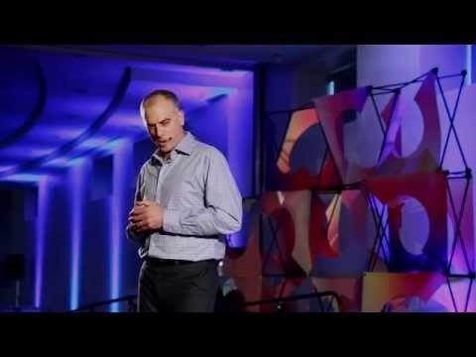
Building a Culture of Inclusion
https://youtu.be/izkN5vLbnw8
Notes:
Set stage for why inclusion is so valuable for students with and without disabilities. Video length is 17.57 min
https://www.youtube.com/watch?v=izkN5vLbnw8

Slide 6
Support for Inclusion
Research
Federal
US Dept. of Education
US Dept. of Health & Human Services
Law & Policy
ADA
IDEA
Professional Organizations
NAEYC
DEC
Notes:
Guidance_document_on_inclusion_of_children_with_disabilities_in_early.pdf (hhs.gov)
https://www.acf.hhs.gov/sites/default/files/documents/ecd/guidance_document_on_inclusion_of_children_with_disabilities_in_early.pdf

Slide 7
Barriers to Implementation
Attitudes and Beliefs
IDEA Interpretation
Lack of Training
Access to Workforce Expertise
Lack of Comprehensive Services
System Collaboration
Notes:
guidance_document_on_inclusion_of_children_with_disabilities_in_early.pdf (hhs.gov)
https://www.acf.hhs.gov/sites/default/files/documents/ecd/guidance_document_on_inclusion_of_children_with_disabilities_in_early.pdf

Slide 8
Activity
List one barrier and identify how you can advocate for inclusion using the “support for inclusion” resources.

Slide 9
Universal Practices in EI/ECSE
Universal Design for Learning (UDL)
Responsive Interactions
Peer Interactions
Embedded Learning Opportunities
Activity Based Intervention
Notes:
EI/ECSE uses universal practices in home and preschool environments that improve outcomes for children and reduces barriers

Slide 10
Universal Design for Learning
https://www.youtube.com/watch?v=bDvKnY0g6e4
Notes:
Introduce UDL with 4.36m video by CAST
UDL At A Glance – YouTube
https://www.youtube.com/watch?v=bDvKnY0g6e4

Slide 11
UDL Values
Every student has their unique learning style
Every student should have an equal opportunity to learn
Change the curriculum, not the student, by removing barriers
Notes:
UDL is not just about including students with disabilities in your curriculum it’s an approach to curriculum that maximizes learning for ALL students.

Slide 12
UDL: A Scientific Approach to Learning
Foundational Research
Principle Research
Promising Practices Research
Implementation Research
Notes:
UDL: Research Evidence (cast.org)
https://udlguidelines.cast.org/more/research-evidence
UDL uses foundational research in learning theories such as Vygotsky’s work on scaffolding which is relevant in all aspects of learning whether a novice or expert.
Reach on the principles of UDL is grounded in neuroscience, there are three networks in our brain for learning and therefore three principles which we will explore in more detail.
Promising practices are contributions to the field that fit in the UDL framework
Implementation research is on specific UDL applications in learning environments
Overall point is that there is strong empirical evidence to support using a UDL framework

Slide 13
UDL Principles
Engagement: The “Why” of learning
The affective network
Representation: The “What” of learning
The recognition network
Action & Expression: The “How” of learning
The strategic network
Notes:
Our learning brain has 3 networks; recognition, strategic and affective the guidelines align with the principles
Engagement – learners are motivated in different ways and there is not one way for each learner so by providing multiple ways to engage learners you are individualizing the curriculum
Representation – learners perceive and comprehend information in different ways, students may be an auditory or visual learner by planning different representation into your curriculum you are reaching more students
Action & Expression – how students can express what they know, for example not everyone is a good test taker, can a student explain verbally better than in writing. By being flexible you will gain a better understanding of your student's knowledge and skills

Slide 14
Engagement I
Recruiting Interest
Spark excitement for learning
Checkpoints
Optimize individual choice and autonomy
Optimize relevance, value and authenticity
Minimize threats and distractions
Notes:
UDL: Recruiting Interest (cast.org)
https://udlguidelines.cast.org/engagement/recruiting-interest
If a child is not paying attention to the information they are not learning…learners differ in what attracts their attention and teachers spend a lot of time trying to engage learners….it’s important to have lots of way of getting students to attend to the lesson…
The UDL checkpoints are listed as specific ways to recruit interest in your learners

Slide 15
Engagement II
Sustaining Effort & Persistence
Approach challenges with focus & determination
Checkpoints
Heighten salience of goals and objectives
Vary demands and resources to optimize challenge
Foster collaboration and community
Increase mastery-oriented feedback
Notes:
Sustaining Effort and Persistence in learning includes suggestions on how to get learners to regulate their attention and affect to sustain the level of concentration needed to complete a task/lesson, teachers have to build on individual skills and equalize accessibility by supporting learners who differ in motivation within a topic or lesson

Slide 16
Engagement III
Self Regulation
The power of motivation in learning
Checkpoints
Promote expectations and beliefs that optimize motivation
Facilitate personal coping skills and strategies
Develop self-assessment and reflection
Notes:
One aspect to human development is our ability to self regulate and develop skills in coping and engaging with our environment. Students can learn to manage their own affect when teachers implement checkpoint in the curriculum

Slide 17
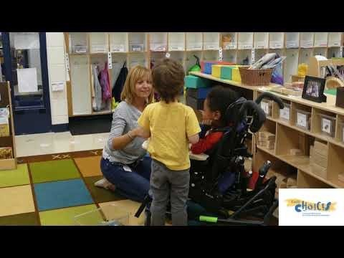
Engagement Activity
https://youtu.be/cPofHKsClBI
Notes:
Show video and stop at 1.48m
https://youtu.be/cPofHKsClBI
How did this teacher use the principle of Engagement? (choices, collaboration…)

Slide 18
Representation I
Perception
Flexible content
Checkpoints
Offer ways of customizing the display of information
Offer alternatives for auditory information
Offer alternatives for visual information
Notes:
One barrier to learning is when learners have to put forth extra effort to perceive information presented by providing flexible content teachers can make information more accessible to all learners, seek to provide the same information through different modalities (vision/touch) and in a format that can be adjusted by the learner (enlarge text/amplify sound)

Slide 19
Representation II
Language & Symbols
Communicate through language that creates a shared understanding
Checkpoints
Clarify vocabulary and symbols
Clarify syntax and structure
Support decoding of text, mathematical notation and symbols
Promote understanding across languages
Illustrate through multiple media
Notes:
We create inequities when only one form of representation is presented to all learners, for example a picture or symbol may mean something different to people in different cultures or there may be a lack of understanding of a specific symbol. We increase clarity and comprehension when we offer access to multiple representations…for example what if we call someone a GOAT…Michael Jordan is the GOAT…in American slang it stands for Greatest Of All Time but could easily be interpreted as negative to someone else. Make sure to clarify vocabulary and symbols and use translations or movement to promote understanding across languages.

Slide 20
Representation III
Comprehension
Construct meaning and generate new understanding
Checkpoints
Activate or supply background knowledge
Highlight patterns, critical features, big ideas and relationships
Guide information processing and visualization
Maximize transfer and generalization
Notes:
Our capability to access knowledge and use it to for new understanding is an active process backed by decades of scientific research….curriculum should be designed to scaffold learning

Slide 21
Representation Activity
Plan a story time using multiple means of representation.

Slide 22
Action & Expression I
Physical Action
Interact with accessible materials and tools
Checkpoints
Vary the methods for response and navigation
Optimize access to tools and assistive technologies
Notes:
Create a curriculum where all learners can interact using materials…see how this teacher incorporated physical action in the classroom

Slide 23
Action & Expression II
Expression & Communication
Compose and share ideas using tools
Checkpoints
Use multiple media for communication
Use multiple tools for construction and composition
Build fluencies with graduated levels of support for practice and performance
Notes:
Level the playing field by providing multiple ways for children to express their knowledge and share ideas

Slide 24
Action & Expression III
Executive Functions
Develop and act on plans to make the most out of learning
Checkpoints
Guide appropriate goal-setting
Support planning and strategy development
Facilitate managing information and resources
Enhance capacity for monitoring progress
Notes:
Executive function is our brain's ability to set goals and develop a plan to reach them, it also includes self-regulation and working memory. For infants and toddlers you can play hiding games and have serve and return conversations. For preschoolers you can boost executive functioning through imitative pretend play and matching and sorting games.

Slide 25
Action & Expression Activity
UDL: Build fluencies with graduated levels of support for practice and performance (cast.org)
Visit the CAST website for checkpoint 5.3
How can you implement this during make-believe play?
Notes:
https://udlguidelines.cast.org/action-expression/expression-communication/fluencies-practice-performance

Slide 26
Responsive Interaction
Awareness of child’s behaviors and communicative signals
Accurate interpretation of child’s signals
Positive and contingent responses to child’s intent
Balanced supports for and challenges to child’s current and future abilities

Slide 27
Responsive strategies
Observation first: what is the child interested in and how can you join the child in that activity?
Noticing and responding to the sounds, expressions, gestures and eye gaze of the child
Building in wait time to allow child response
Commenting on child behaviors
Imitating the child
Delighting in the child’s presence
Notes:
Kim, J. M., & Mahoney, G. (2004). The effects of mother's style of interaction on children's engagement: Implications for using responsive interventions with parents. Topics in Early Childhood Special Education, 24(1), 31-38.

Slide 28
Responsive Interactions - Video
Watch these interactions and identify some responsive strategies you see being used here
What learning was happening in each of these interactions?

Slide 29
Responsive Interactions - Video
https://youtu.be/NEBGTno08mA
Notes:
https://youtu.be/NEBGTno08mA

Slide 30
Universal Strategies: Including Peers
https://youtu.be/45DV6bGo-hk
Notes:
Peer relationships are critical for a child’s development and social competence. Review this video on how peer relationships are being developed in this inclusive play group. What are some of the benefits you can identify for the children with and without disabilities?
https://youtu.be/45DV6bGo-hk

Slide 31
Embedded Learning Opportunities
Adults implement short teaching events within everyday activities, routines and transitions to promote child learning.
Example:
Video 7.17: Letters on the alphabet tree | Connect Modules (dec-sped.org)
Notes:
https://connectmodules.dec-sped.org/connect-modules/resources/videos/video-7-17/

Slide 32
Activity Based Intervention
Focus on functional goals that are meaningful and developmentally appropriate
Intervention is embedded into everyday activities and routines
Activities are child-directed and individualized
Timely and integral feedback is provided
Notes:
Adults mediate children’s experiences to promote learning through activity based intervention – adults can use modeling, imitation and expand on a child’s language and play in the child’s natural environment. This intervention focuses on functional goals that are developmentally appropriate.
Can tie child-directed back to UDL principle of “engagement”
Kristie Pretti-Frontczak and Dian Bricker “An activity-based approach to early intervention”

Slide 33
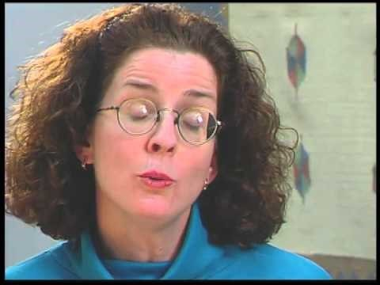
Jenni’s Story
https://youtu.be/iKklSA3cFsE
Notes:
Using what you know about universal design, watch this EI video and identify universal practices/intervention used with Jenni
Think back to our discussions on
Environment/Context, Responsive Interactions, Activity Based Intervention and Peer interactions how was that used specifically with Jenni?
What did you notice about how the team collaborated?
How did they specifically address the family’s needs?
https://youtu.be/iKklSA3cFsE

Slide 34
References
UDL: The UDL Guidelines (cast.org)
Guidance document on inclusion of children with disabilities in early.pdf (hhs.gov)
Kim, J. M., & Mahoney, G. (2004). The Effects of Mother’s Style of Interaction on Children’s Engagement: Implications for Using Responsive Interventions With Parents. Topics in Early Childhood Special Education, 24(1), 31-38.
Pretti-Frontczak, K., & Bricker, D. (2004). An activity-based approach to early intervention. Paul H. Brookes Publishing.
Odom SL, Wolery, M. A Unified Theory of Practice in Early Intervention/Early Childhood Special Education: Evidence-Based Practices. The Journal of Special Education. 2003;37(3):164-173. doi:10.1177/00224669030370030601
Notes:
https://udlguidelines.cast.org/
https://www.acf.hhs.gov/sites/default/files/documents/ecd/guidance_document_on_inclusion_of_children_with_disabilities_in_early.pdf
https://journals.sagepub.com/doi/10.1177/00224669030370030601

Slide 35
Disclaimer

