Slide 1
Collaboration and Teaming
Initial Practice Based Professional Standards for Early Interventionists/Early Childhood Special Educators (EI/ECSE)
3.3

Slide 2
Standard 3
Candidates apply models, skills, and processes of teaming when collaborating and communicating with families and professionals, using culturally and linguistically responsive and affirming practices. In partnership with families and other professionals, candidates develop and implement individualized plans and successful transitions that occur across the age span. Candidates use a variety of collaborative strategies while working with and supporting other adults.

Slide 3
Component: 3.3
Candidates partner with families and other professionals to develop individualized plans and support the various transitions that occur for the young child and their family throughout the birth through 8 age span.

Slide 4
Objectives
Identify the legal requirements for transition planning in EI/ECSE
Identify evidence-based and promising practices for developing transition plans into and from EI and into and from ECSE
Describe strategies to partner with families to develop transition plans

Slide 5
Transitions in EI/ECSE Practice
DEC: Transition refers to the events, activities, and processes associated with key changes between environments or programs during the early childhood years and the practices that support the adjustment of the child and family to the new setting
A dynamic process

Slide 6
Transitions in EI/ECSE Practice
Between Systems:
Hospital to Birth to Three
Birth to Three to Pre-K
Pre-K to K-21
Within Systems:
Change of providers, teacher, caregiver, etc.
ESY

Slide 7
Transitions: 5 Broad Objectives
Continuity of services
Minimal disruptions to the family system
Ability of children to function in their new program
Compliance with legal requirements
Facilitate child and family competence along a continuum of skills that are both developmentally and individually appropriate
Bruder (2010): Transitions for Children with Disabilities

Slide 8
Hospital to Part C (Birth to Three)
Children with conditions identified at birth more likely to be referred and engage with services
NICU graduates: Lower rate of referral and receipt of services than expected for eligible infants
Infants with NAS/NOWS even lower
Hearing screens – thousands of infants lost to follow up
Notes:
Discuss possible reasons for lower-than-expected rates of referral from hospital settings

Slide 9
Part C (Birth to Three) Service Coordination
The role of the service coordinator before and during the meeting should be to support the capacity of the parent or caregiver to describe their child's abilities and challenges and identify potential strategies to support their learning

Slide 10
Transitioning to Part C (Birth to Three)
Watch the video on the next slide before discussing the following questions;
What did you hear from parents about their experiences during this process?
What would you as a practitioner want to hold in mind as you supported them through their entry into services?
These were families that successfully engaged with services. What barriers can you imagine might come up for families that result in a lack of engagement with Part C services?
Notes:
https://ectacenter.org/decrp/topic-transition.asp → video on next slide
What did you hear from parents about their experiences during this experience?
What would you as a practitioner want to hold in mind as you supported them through their entry into services?
These were families that successfully engaged with services. What barriers can you imagine might come up for families that result in a lack of engagement with Part C services?
(the unknown, so much fear to begin with) – trying not to overwhelm

Slide 11
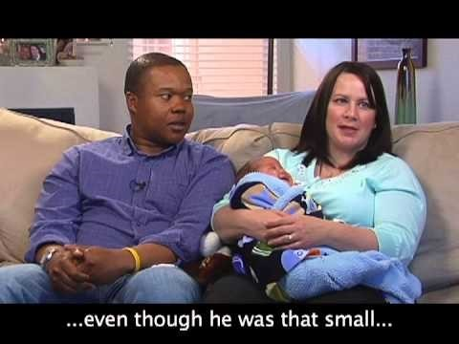
Video: What Is It Like to Begin Services?
https://youtu.be/-w804ZXczj0
Notes:
https://ectacenter.org/decrp/topic-transition.asp
https://youtu.be/-w804ZXczj0

Slide 12
Part C (Birth to Three) to Part B/619 (Pre-K)
Families with IFSPs are entitled to a transition plan to facilitate access to other services when the child turns 3
IDEA regulations include transition as one of the areas that must be addressed in the IFSP
Notes:
The IDEA Part C law has regulations about transition and what the process needs to include (such as holding a transition meeting, referral information to lead education agencies, etc.).
Your agency may also have written documentation regarding the transition process, or checklists to follow as you work with families. Remember, this is a big step for them and it is our job to support their needs and build on their strengths.
Also, it is important for you to be aware of the variety of options for 3-year old children in the state. There are several preschool program options such as Head Start, School Readiness, Smart Start, District Preschool Special Education, etc. Make sure you are up to date on program information and options that you can share with families to help support them in their choice of where to send their child after they turn 3- years old.
The Connecticut State Department of Education website should provide the most current information: https://portal.ct.gov/SDE ,
https://portal.ct.gov/SDE/Special-Education/Early-Childhood-Special-Education
In Connecticut, the statewide IFSP form includes a section to record a transition plan. This section explores the many possible outcomes that could be important for a family.

Slide 13
Transition Requirements
A transition meeting must occur at least 90 days prior to a child's third birthday
The early childhood agency must initiate the meeting
States must report compliance to OSEP
Families must be informed of their rights and responsibilities during the transition process
Notes:
Locate parent’s rights on state EI or 619 websites

Slide 14
Part C (Birth to Three) to Part B/619 (Pre-K)
One family’s story
On the next slide, listen to this family’s story; what strategies do you think would be most important to help with this transition?
Notes:
https://eclkc.ohs.acf.hhs.gov/children-disabilities/specialquest-multimedia-training-library/session-9-transition-age-3
Families need information, resources, and support to make informed decisions about services for their child when the child turns 3.
While infant/toddler and preschool programs recognize the child must be viewed in the context of his/her family, preschool special education (Part B) services typically are more child focused, while early intervention (Part C) services have a stronger focus on the family.
For families whose children qualify for preschool special education, changes in services at age 3 will occur as a result of the differences in philosophy and legislative intent of early intervention (Part C) and preschool special education (Part B).
Differences in focus of services from Part C to Part B (families, settings)
Families need to prepare for transition and incorporate their priorities and preferences for their child into the planning process.

Slide 15
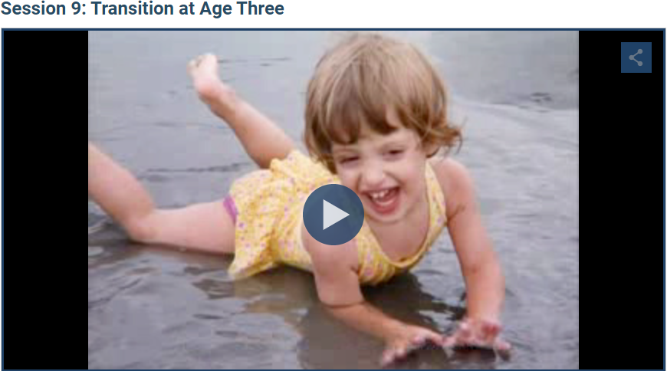
Video: Transition at Age Three
https://view.vzaar.com/5599111/player?apiOn=true&GAOn=true
Notes:
Session 9: Transition at Age 3 | ECLKC (hhs.gov)
https://view.vzaar.com/5599111/player?apiOn=true&GAOn=true

Slide 16
Elements of Transition Planning
Relationship-building across community partners
Service providers help families understand differences between systems
Provide families about their rights/responsibilities to make informed choices
Families choose who they want to invite to IEP
Transition IFSP meetings must take place no later than 90 days before—and with parent’s consent as early as nine months before— the child’s third birthday
Include explicit steps to exit the program

Slide 17
Transition Planning
Unique strengths, learning styles, special needs, and family context are always considered
Changes in services: different eligibility and system requirements
Supports child development without loss of or interruptions in needed services
Opportunities developed for children to become familiar and comfortable with new services and settings

Slide 18
Part B/619 to Kindergarten: Ensuring a Seamless Transition
Form a transition team and articulate a plan for collaboration
Obtain permission and share key records
Ensure that all staff on both ends are fully informed about respective policies and procedures so that families receive accurate information and advocate for their child
Provide opportunities for families and providers to visit a new classroom and assess environmental/adaptive needs to optimize full participation
Prepare child through books, visual stories, classroom visits
Create an ongoing plan for communication
Notes:
Form a transition team: family, teachers, administrators, EI/ECSE providers choosing a lead to develop and implement transition plan
Obtain permission and share key records to coordinate team collaboration to design a fully-loaded IEP plan to ensure success
Ensure that all staff on both ends are fully informed about respective policies and procedures so that families receive accurate information
Provide opportunities for families and providers to visit new classroom and assess environmental needs
Prepare child through books, stories, classroom visits
Construct ongoing plan for communication
Collaborate with the transition team, including families, to coordinate child health care resources and community-based services (e.g. suggest outdoor spaces for safe and independent free play)
Prepare the family and child for changes in roles and routines (e.g., child taking on the student role, caregiver participation differences in school versus early intervention)
Educate the family and school staff on diverse needs of the child in the new setting (e.g., educating a family about how a child’s disability will impact school participation and how this will be addressed)
Evaluate ways to support school participation (e.g. observe how the student gets along with others
Facilitate skills needed for school participation (e.g. create opportunities for student to play with others at recess
Enhance play and social skills for the school environment (e.g., provide opportunities for supported cooperative play)

Slide 19
Evidence-Based Transition Practices
Family-centered approach/involvement in planning that promotes continuity of experiences
Providing clear, understandable, and accurate information
Fostering relationships
Interagency agreements and communication
Ongoing family support over time

Slide 20
Activity #1: Aiden’s Transition
Questions:
What child and family strengths should be considered in Aiden’s transition?
What child and family characteristics should be considered in Aiden’s transition?
Imagine you are the service coordinator (Miss Sara): what did you do before, during and after the meeting to support competence in this mother’s (Gwen) ability to participate in Aiden’s transition actively?
Case-Study-Aiden-Coordination.Collaboration.pdf (ecpcta.org)
Notes:
Using the content you gained from today’s session and the ECTA Handout: Supporting Transition from EI to Preschool, consider Aiden’s transition plan:
https://ecpcta.org/wp-content/uploads/sites/2810/2021/01/Case-Study-Aiden-Coordination.Collaboration.pdf

Slide 21
References and Resources
Tang, B.G., Feldman, H.M. et al., (2012). Missed Opportunities in the referral of high-risk infants to early intervention. Pediatrics, 129(6)
Chambers, E.P., Leyenaar, J.K. et al., (2019). Early Intervention Referral and Enrollment Among Infants With Neonatal Abstinence Syndrome. Journal of Developmental Behavioral Pediatrics; 40(6): 441-450
Notes:
https://www.sciencedirect.com/science/article/pii/S0010782415001018?via%3Dihub
https://journals.lww.com/jrnldbp/Fulltext/2019/08000/Early_Intervention_Referral_and_Enrollment_Among.5.aspx

Slide 22
References and Resources
Birth-to-Three Family Handbook (Guide 3: Transition to Early Childhood Special Education) (2013)
ECTA Practices Improvement Tools: Transitions https://ectacenter.org/decrp/topic-transition.asp
Notes:
https://www.birth23.org/files/Families/FamilyHandbookIII.pdf
https://ectacenter.org/decrp/topic-transition.asp

Slide 23
References and Resources
Dunst, C.J., (2017). Research Foundations for Early Childhood Intervention Performance Checklists, Educational Science; 7(78).
DEC recommended practices in early intervention/early childhood special education 2014. Retrieved from http://www.dec-sped.org/recommendedpractices
Notes:
https://www.mdpi.com/2227-7102/7/4/78/htm
https://www.dec-sped.org/dec-recommended-practices

Slide 24
Disclaimer

