Slide 1
Collaboration and Teaming
Initial Practice Based Professional Standards for Early Interventionists/Early Childhood Special Educators (EI/ECSE)
3.2

Slide 2
Standard 3
Candidates apply models, skills, and processes of teaming when collaborating and communicating with families and professionals, using culturally and linguistically responsive and affirming practices. In partnership with families and other professionals, candidates develop and implement individualized plans and successful transitions that occur across the age span. Candidates use a variety of collaborative strategies while working with and supporting other adults.

Slide 3
Component: 3.2
Candidates use a variety of collaborative strategies when working with other adults that are evidence-based, appropriate to the task, culturally and linguistically responsive, and take into consideration the environment and service delivery approach.

Slide 4
Objectives
Describe evidence-based collaborative strategies to use when working with other adults, including supervision, coaching and mentoring strategies.
Describe evidenced-based collaborative strategies to use when working with other adults that are culturally and linguistically responsive, and adaptable to the needs of the task, environment and service delivery approach.

Slide 5
Evidence-Based Collaboration
Early Intervention/Early Childhood Special Education (EI/ECSE) is the primary service for infants and preschool children with disabilities
Blended instructional methods drawn from professional literature and research
Evidence-based practice is a process used by practitioners to integrate the best available research evidence with family and professional wisdom and values (DEC)

Slide 6
Evidence-Based Collaboration
Families and professionals can make informed decisions that directly benefit their child and family
Evidence-based practices require attention to local circumstances, consumer values, and knowledge about the child and their families (Buysse et al., 2016)

Slide 7
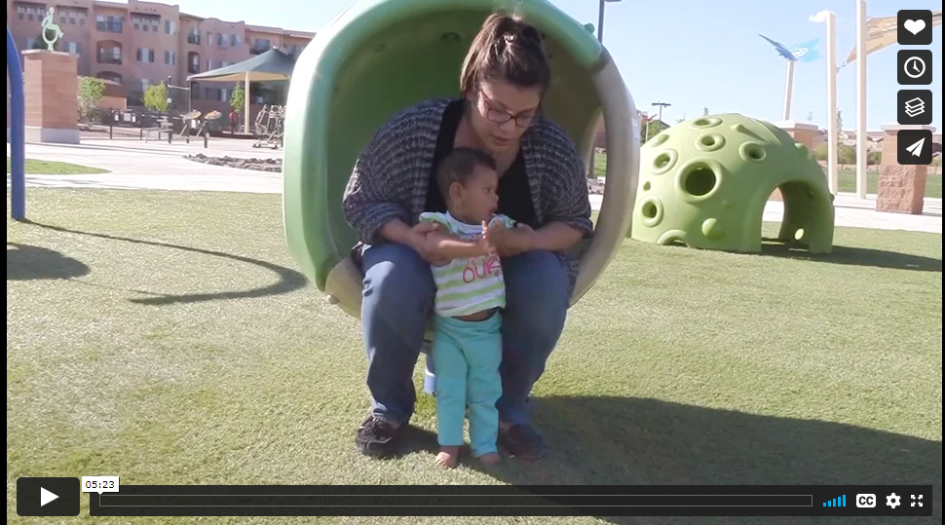
The Power of Coaching
https://vimeo.com/showcase/3896061/video/184931075
Notes:
https://vimeo.com/showcase/3896061/video/184931075
One evidence-based practice for collaboration with families is coaching….let’s look at the power of coaching in EI.
Considering both sessions were “successful” what are the differences you observed in the 2 mothers, which Mother do you think feels more competent in implementing strategies between visits?

Slide 8
What is Coaching?
“An adult learning strategy in which the coach promotes the learner’s ability to reflect on his or her actions as a means to determine the effectiveness of an action or practice and develop a plan for refinement and use of the action in immediate and future situations.” (Rush & Shelden, 2005, p. 3)
Notes:
Introduce coaching as an evidence based adult learning strategy

Slide 9
5 Characteristics of Coaching
Joint Planning
Observation
Action/Practice
Reflection
Feedback
Notes:
There are 5 characteristics of coaching according to Rush & Shelden, we will discuss each characteristic and how it can be applied in EI/ECSE practices. Note: The characteristics are fluid throughout the coaching process and do not follow a specific order

Slide 10
Joint Planning
Part 1
Discussion on what will happen between visits
Part 2
Planning for the next visit
Notes:
Joint planning is a reciprocal 2-part process that starts with a discussion between the practitioner and the parent where they identify what will be worked on between visits. This isn’t prescriptive on the part of the practitioner the parent should be actively participating.
The plan should be specific and it’s best to have it in writing so it’s clear to both parties what will be worked on and how follow up will occur at the next visit.
Follow up must occur as it starts the process/discussion for the next visit.

Slide 11
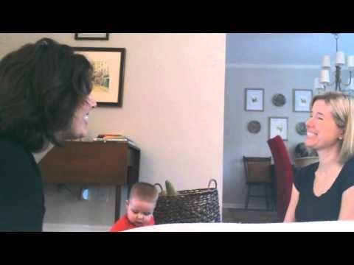
Joint Planning Example
https://youtu.be/ZDx9L6yPMZU
Notes:
https://youtu.be/ZDx9L6yPMZU
Have participants identify the 2-part process in the video
Also can discuss how this is different than a consult where the practitioner is giving information or strategies without parent input

Slide 12
Observation
Parent Observation
Observe with intent
Be objective
Take notes
Practitioner Observation
Be specific
Demonstrate additional strategies
Follow up with open ended questions
Notes:
Observation is a key component of the coaching process as it not only allows the practitioner to model strategies it also provides an opportunity for the practitioner to view the parent/child interactions which can lead to discussions and reflection. Observations should occur in the families everyday routines and activities where they are most comfortable
When observing a parent interaction the practitioner should observe with intention- focus on the goal/task that you are working on, be objective and unbiased during your observation time. If needed take notes so you can better reflect with the parent.
When a practitioner is modeling a strategy they should ask the parent to make specific observations and build on what the parent is already doing. Follow up with questions like “how do you think that will work for you” or “is that something you feel would work for (child)”

Slide 13
Action/Practice
https://youtu.be/_hcrgNRP7fk
Notes:
Show video on Action/Practice by Rush & Shelden
https://youtu.be/_hcrgNRP7fk
Discuss the importance of practice in adult learning. The practice does not always have to occur in the form of observation, it can occur between visits. Think back to the video we watched on joint planning and how the mother practiced messy eating. Remember the goal of coaching is to build the capacity of the parent.

Slide 14
Reflection
Awareness
Promote understanding of what is already known
Alternatives
Consider options to address the goal
Analysis
Compare current understanding with desired goal
Action
Develop a plan to reach a goal
Notes:
There are 4 types of reflection questions a practitioner can use during a coaching visit to help the parent achieve an deeper understanding
Possible Activity; use handout and have participants role play a reflection
quik_ref_coaching_guide_june2013.pdf (veipd.org)

Slide 15
Feedback
Affirmative
Active listening “I see what you mean”
Evaluative
Providing a judgement “I like how you did that”
Informative
Sharing information and/ or giving suggestions
Directive
Telling someone what to do
Notes:
Affirmative feedback is verbal and non-verbal actions that let someone know you are listening
Evaluative feedback is providing a judgement and following up with WHY you are placing that judgement “I like how you pointed to the plane because it refocused the child’s attention”
Informative feedback is what we most often want to give and it can be easy to just share your ideas and suggestions but a good coach will try to merge their ideas with the parents because our role is to build capacity in the parents so they should brainstorm ideas first!
Directive is basically telling someone what to do before you get more information on what they have already tried or what the parent knows. Only use when there is a safety concern.

Slide 16
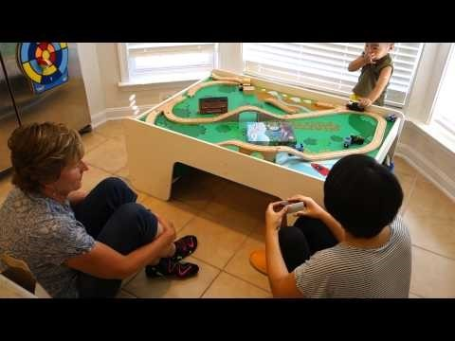
Feedback video
Play Video from 4:15-5:20
https://youtu.be/ziColpqpLIo
Notes:
Play Video from 4:15-5:20
What forms of feedback did the practitioner use?
https://youtu.be/ziColpqpLIo

Slide 17
Coaching Myths & Misconceptions
People just want to be told what to do and coaching doesn’t work with all families
Coaching doesn’t work for children who are medically fragile or have severe disabilities
Physicians refer for early intervention therapy services not coaching
Coaching is not a billable service
Coaching is watered down approach
Notes:
Can use slide or show video (https://youtu.be/LhbzZh27SZY)
Myth: Research on adult learning does not show knowledge and skill development when practitioners simply tell people what to do. It shows that finding out someone’s knowledge prior and working together is a hook to deeper learning. We must partner with the adults in a child's life, so they know what to do and have the confidence to implement their ideas.
Myth: Coaching is not a hands-off approach it’s an interaction style with the parents, so the child’s characteristics are not a factor.
Myth: Articles have been published in the Journal of Pediatrics, published by the American Academy of Pediatrics (October 2013 edition) that support the use of coaching to build parent or teacher capacity in the context of natural environments.
Myth: Coaching is an interaction style and does not “replace” therapy. Think of a physician's bedside manner, they do not get paid because they have good or poor bedside manner, they get paid for the service they are providing. Coaching is how we interact with parents and not create dependence so they can support the child when the practitioner is not present. Only working on skills during visits will not help a child progress.
Coaching is a partnership, and the practitioner should be involved in what is happening within the routine as skills are being practiced

Slide 18
Video: Coaching Myths & Misconceptions
https://youtu.be/LhbzZh27SZY
Notes:
Can use slide or show video (https://youtu.be/LhbzZh27SZY)
Dathan and M'Lisa Top Ten – YouTube
https://www.youtube.com/watch?v=LhbzZh27SZY

Slide 19
Implementation Fidelity
Collect and use data to make decisions on how coaching practices are working to improve outcomes for children and families
Use research-based tools to measure coaching fidelity
Take video for reflection and feedback
Consult with mentors and peers
Notes:
When your program chooses a coaching approach its important that you set expectations to implement coaching with fidelity. Data should be collected on coaching practices as well as the child and parents progress while using the principles of coaching. A research based tool like SS-OO-PP-RR can be used to assist with fidelity since we have a responsibility to implement a research based approach as it was designed and tested to maintain quality programming. Practitioners can also use video and peers to review implementation in order to get feedback on coaching practices.
Romano & Schnurr

Slide 20
Cross-Disciplinary Coaching
Purpose
The team has one expert on the child and family
Benefits
Relationship development
Efficient
Improved Communication
Culturally Responsive
Notes:
The purpose of using a primary service provider approach to teaming is to allow ONE team member to become the expert on the child and their family and to reduce the amount of practitioners coming into the home or contacting the family. There are several benefits to this approach; easier to develop a trusting relationship, more efficient use of program resources, improved communication between family and team, and more likely to be culturally responsive because the team can choose who will be a good fit for the family.
(Shelden & Rush)

Slide 21
Culturally Responsive Coaching
An effective coach must be open and willing to listen and learn about a family's personal beliefs and be able to incorporate their perspective into the coaching process
An effective coach must have an awareness of their own bias and be able to offer feedback without bias
An effective coach must use a strength-based approach and respect the families' unique characteristics
Notes:
Provide historical context that marginalized children have been subject to injustices in early childhood settings. Teachers and early interventionist have a responsibility to increase their awareness of the issues and make efforts to decrease inequities.
For more information; Culturally Responsive Practices in Coaching | ECLKC (hhs.gov)

Slide 22
Coaching Strategies
Use self reflection practices to identify your perspectives and beliefs that may influence interactions
Ask caregivers how they learn best/retain information to apply adult learning best practices
Get comfortable with creating solutions when there are opposing perspectives. Coaches need to remove judgement, personal beliefs and emotions in order to make joint decisions.
Use data and conversation skills to gain understanding of the caregivers individual needs and affirm the caregivers strengths, they are the expert on their child.
Notes:
cult-resp-strategies.pdf
https://laulima.hawaii.edu/access/content/user/jaydene/ED294/ED294.cult.resp.teaching.pdf

Slide 23
References
Buysse, V., Wesley, P. W., Snyder, P., & Winton, P. (2006). Evidence-Based Practice: What Does It Really Mean for the Early Childhood Field? Young Exceptional Children, 9(4), 2-11.
Coaching in Early Childhood: Primary Coach Approach to Teaming
The Coaching Quick Reference Guide june2013.pdf (veipd.org)
Kemp, P. & Turnbull, A. (2014). Coaching With Parents in Early Intervention: An Interdisciplinary Research Synthesis. Infants & Young Children, 27(4), 305-324.
Shelden, M., & Rush, D. D. (2013). Early intervention teaming handbook. Brookes.
Culturally Responsive Practices in Coaching | ECLKC (hhs.gov)
Romano, M., & Schnurr, M. (2020) Mind the Gap: Strategies to Bridge the Research-to-Practice Divide in Early Intervention Caregiver Coaching Practices. Topics in Early Childhood Special Education. doi:10.1177/0271121419899163
Notes:
http://www.coachinginearlychildhood.org/pcateamingintro.php
https://www.veipd.org/main/pdf/toolsoftrade/quik_ref_coaching_guide_june2013.pdf
https://journals.lww.com/iycjournal/Fulltext/2014/10000/Coaching_With_Parents_in_Early_Intervention__An.4.aspx
Culturally Responsive Practices in Coaching | ECLKC (hhs.gov)
https://eclkc.ohs.acf.hhs.gov/video/culturally-responsive-practices-coaching

Slide 24
Disclaimer

