Slide 1
Addressing Autism in Early Intervention Practice
Characteristics, Etiology, Screening, and Diagnosis

Slide 2
Autism Modules 1 and 2: Introduction
This resource, consisting of 2 modules, is designed to provide EI/ECSE professionals with a functional understanding of autism spectrum disorder (ASD) in young children, how to support early identification, diagnosis, and referral to services, and to review effective, evidence-based interventions designed for use with this population.
Before you get started with this module, please create a sign-in name and password at Autism Navigator Resources: https://resources.autismnavigator.com/. After you sign in, you will have access to each of the video activities you will complete over the course of the Module.

Slide 3
Overview: Module 1
Given that Autism Spectrum Disorder (ASD) emerges from birth and is identifiable in the first years of life, it is critically important that families and professionals alike are prepared to recognize the early signs of ASD and identify the criteria for an ASD diagnosis. Identification is the first step towards ensuring that children at-risk for or who have ASD have access to evidence-based services designed for young children in the context of natural caregiving routines - to optimize life-long developmental trajectories.

Slide 4
Objectives
Describe the characteristics, prevalence, and etiology of Autism Spectrum Disorder (ASD)
Describe the importance of early identification for children with ASD
List specific strategies used to screen young children for autism risk
List common signs of early autism and what they look like in the context of observation and assessment
List the components of a diagnostic evaluation for ASD
Describe diagnostic tools commonly used with young children at-risk for or who have ASD

Slide 5
What is Autism Spectrum Disorder?
Autism is one word attempting to describe millions of different stories
Stuart Duncan, creator of Autism from a Father’s Point of View
Notes:
http://www.stuartduncan.name/
https://www.patreon.com/autismfather

Slide 6
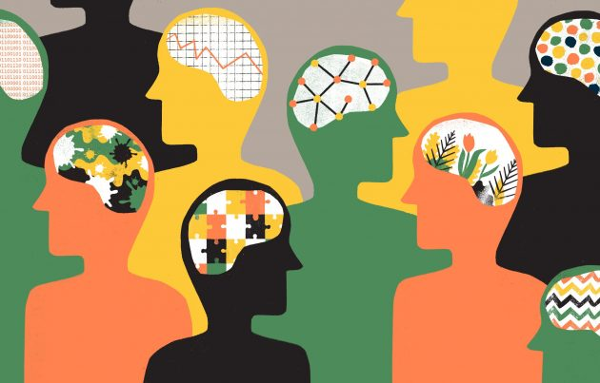
Autism Spectrum Disorder (ASD)
A neurodevelopmental disorder that emerges from the time of birth
Different for every individual
Notes:
Although there is still much to learn about ASD, research supports the notion that ASD is present at the time of birth. Characteristics of ASD emerge over the first years of life having to do with both genetic and environmental variables – and will look different for each individual.
(Bauminger-Zviely et al., 2014)

Slide 7
Characteristics of Autism
Decreased social interaction and social communication
Restricted and repetitive interests and activities
Sensory differences
Affects all ethnic and socioeconomic groups
31% of children with ASD have an intellectual disability
(Maenner et al., 2020)
Notes:
First identified by Dr. Leo Kanner in the mid-thirties, the DSM-5 lists the following characteristics of autism spectrum disorder, or ASD:
Decreased social interaction, including social-emotional reciprocity – children are less likely to invite others to share social attention, and we see many fewer back-and-forth interactions with others, which we know are so important to the development of social cognition. As a result, children with autism do not develop, maintain, and understand relationships and relationship contexts in the same way that typically-developing children do.
Decreases in nonverbal communication used for social interaction: fewer instances of eye gazes, pointing, showing – gestures and expressions that enable children to initiate and share attention with other, and delays in the onset of verbal language.
Stereotyped or repetitive movements, and/or highly restricted and fixated interests that are really intense, as compared to typically-developing children. We also see a strong preference for sameness, and a strict or even ritualized pattern of adherence to specific routines. Sensory differences are also often present, including increased sensitivity to touch, sounds, light, other visual stimuli. Many children also experience a concurrent decrease in sensitivity to pressure and proprioception (the perception of their bodies in space), and behaviors problems may emerge around seeking this kind of sensory input (e.g., head-banging, spinning, other sensory-seeking behaviors). They may have a decreased response to the experience of pain.
As you know, individuals with autism may display a wide range of severity for each of these symptoms, and may present very differently from one individual to the next. Those with more severe symptoms often show intellectual disability, while the majority may have normal or above-normal intellectual ability
31% of children with ASD have an intellectual disability (intelligence quotient [IQ] <70), 25% are in the borderline range (IQ 71–85), and 44% have IQ scores in the average to above average range (i.e., IQ >85).
Individuals with a Autism Spectrum Disorder (ASD) diagnosis can look very different from each other because characteristics present differently in every person and are impacted by the environment
Example: One child with ASD may talk a lot, but only about favorite topics (e.g., Paw Patrol, sharks and butterflies); while another child with ASD may not talk at all and have an intense and very specific interest in specific objects (e.g., phones, fans, cars). Another child may not yet be interested in objects at all, but may prefer sensory stimuli, such as visual fixations, jumping, flapping, or spinning.
Since autism emerges from the time of birth, there is plenty of time – especially in the first years of life, for the environment to influence the characteristics of autism. For example, when symptoms are identified early, families and professionals can increase the salience of social stimuli while the brain is still highly plastic – we will talk about that in jut a few minutes.
Bradshaw, J., McCracken, C., Pileggi, M., Brane, N., Delehanty, A., Day, T., ... & Wetherby, A. (2021). Early social communication development in infants with autism spectrum disorder. Child Development, 92(6), 2224-2234. https://doi.org/10.1111/cdev.13683

Slide 8
Prevalence of ASD
From the Centers for Disease Control (2021):
https://www.cdc.gov/ncbddd/autism/data.html
1 in 44 Children in the US
1 in 27 boys - 1 in 116 girls
Boys 4 times more likely to be diagnosed
Girls may be more likely to “camouflage” resulting in under identification
(Dean, M., Harwood, R., & Kasari, C., 2017)
Notes:
In 2021, the CDC reported that approximately 1 in 44 children in the U.S. is diagnosed with an autism spectrum disorder (ASD), according to 2018 data. (Autism Speaks, 2021)
1 in 27 boys identified with autism
1 in 116 girls identified with autism
Boys are four times more likely to be diagnosed with autism than girls.
Most children are still being diagnosed after age 4, though autism can be reliably diagnosed as early as age 2.
Autism affects all ethnic and socioeconomic groups.
Minority groups tend to be diagnosed later and less often.
Dean, M., Harwood, R., & Kasari, C. (2017). The art of camouflage: Gender differences in the social behaviors of girls and boys with autism spectrum disorder. Autism, 21(6), 678–689. https://doi.org/10.1177/1362361316671845

Slide 9
Impact
The “severity” of ASD is determined by the degree to which differences in social interaction and communication and/or restricted/repetitive interests impact a child’s ability to participate in daily life
(Bauminger-Zviely et al., 2014)
Notes:
As we have noted, this impact is very likely affected by the child’s environment (i.e., home, school, community).
Environments that provide support and accommodations for the child’s needs allow the child to participate in meaningful childhood experiences to foster skill development.

Slide 10
Associated Challenges
~40% of people with ASD are preverbal/nonverbal
Nearly half of people with ASD wander or bolt from safety
28% of children with ASD have self-injurious behaviors like head banging, arm biting, skin scratching
Nearly 2/3 of children with ASD between the ages of 6 and 15 have been bullied
Notes:
From Autism Speaks: Statistics and Facts:

Slide 11
Associated Conditions
Children with ASD are more likely to:
Also have Attention Deficit Hyperactivity Disorder (ADHD)
Be affected by anxiety disorders and depression
Have chronic gastrointestinal disorders
Have chronic sleep problems
Have epilepsy
Notes:
From Autism Speaks: Statistics and Facts:
Autism can affect the whole body.
Attention Deficient Hyperactivity Disorder (ADHD) affects an estimated 30 to 61 percent of children with autism.
More than half of children with autism have one or more chronic sleep problems.
Anxiety disorders affect an estimated 11 to 40 percent of children and teens on the autism spectrum.
Depression affects an estimated 7% of children and 26% of adults with autism.
Children with autism are nearly eight times more likely to suffer from one or more chronic gastrointestinal disorders than are other children.
As many as one-third of people with autism have epilepsy (seizure disorder).

Slide 12
Associated Strengths
Children of all abilities have strengths!
Strengths not necessarily dependent on verbal ability, IQ scores, social skills
Among a wide range of individual strengths, some people with ASD may also have enhanced visual and auditory perception and pattern detection abilities (e.g., Mottron et al., 2009)
Adults with ASD have reported increased ability to focus, attend to detail, remember facts, experiences or conversations (e.g., Russell et al., 2019)
Other shared strengths have yet to be fully researched – for example: increased likelihood of engagement in moral decision-making/honesty (e.g., Hu et al., 2020), reliability, loyalty.
Notes:
The evidence based of autism as a whole uses a deficit-based lens – and most of what we know in turn is about the challenges and deficits of children with ASD. What research has not yet examined is what may constitute the unique strengths of people with ASD.
Increasingly, the autistic community is advocating for more research performed by scientists with autism, and for science to acknowledge and elevate the strengths of neurodivergent people as a whole. This focus on the strengths as well as challenges of people with autism is particularly relevant to the practice of working with young children with ASD and their families.
The identification of individual strengths is an essential part of the assessment and planning process in early intervention as a means to make sure that the unique interests and focuses of children with ASD are incorporated into every aspect of intervention and instruction – and elevating the reality that children with ASD are valued and whole members of their family and their communities. They are not broken – and early intervention providers hold the responsibility of making sure that everything they do empowers the child to make choices, to have their own unique interests, to participate with typically developing peers, and to engage in self-determination. This does not mean ignoring the often very specific interests and preferences of the child, which we will discuss in the Intervention Models section of this Module.
Sources:
Mottron, L., Dawson, M., and Soulières, I. (2009). Enhanced perception in savant syndrome: patterns, structure and creativity. Philosophical Transactions of the Royal Society B, 364: 1385-1391.
https://doi.org/10.1098/rstb.2008.03333
Hu, A, Xiaoxu, G., Campos, P.M., Derrington, E. et al., (2020). Right Temporoparietal Junction Underlies Avoidance of Moral Transgression in Autism Spectrum Disorder
Journal of Neuroscience 24 February 2021, 41 (8) 1699-1715; DOI: 10.1523/JNEUROSCI.1237-20.2020
Russell, G., Kapp, S.K., Elliott, D., Elphick, C. et al. (2019). Mapping the Autistic Advantage from the Accounts of Adults Diagnosed with Autism: A Qualitative Study, Autism in Adulthood.124-133. http://doi.org/10.1089/aut.2018.0035
From: https://www.spectrumnews.org/features/deep-dive/finding-strengths-in-autism/

Slide 13
Video Activity
Watch this video: Amazing Things Happen (4 min)
Identify one way this video supported your understanding of autism
Identify one way this perspective informs your approach to serving young children with autism and their families
Notes:
Amazing Things Happen

Slide 14
ASD: A Complex Etiology
Not caused by vaccines! (Anders et al., 2019)
Genetically mediated
Influenced by environmental factors
Involving both genetic and environmental factors, ASD is a consequence of cascading developmental events from the beginning of life, beginning with decreased attention to faces and social stimuli
Notes:
Most scientists agree that genes are one of the risk factors that can make a person more likely to develop ASD.
Children who have a sibling with ASD are at a higher risk of also having ASD.
Individuals with certain genetic or chromosomal conditions, such as fragile X syndrome or tuberous sclerosis, can have a greater chance of having ASD.
When taken during pregnancy, the prescription drugs valproic acid and thalidomide have been linked with a higher risk of ASD.
There is some evidence that the critical period for developing ASD occurs before, during, and immediately after birth.
Children born to older parents are at greater risk for having ASD.
Sources:
Hyman, S.L., Levy, S.E., Myers, S.M., & Council on Children with Disabilities, Section on Developmental and
Behavioral Pediatrics (2020). Identification, evaluation, and management of children with autism spectrum disorder. Pediatrics, 145(1):e20193447 https://doi.org/10.1542/peds.2019-3447.
Anders Hviid, Jørgen Vinsløv Hansen, Morten Frisch, et al. Measles, Mumps, Rubella Vaccination and Autism: A Nationwide Cohort Study. Ann Intern Med.2019;170:513-520. [Epub ahead of print 5 March 2019]. doi:10.7326/M18-2101
https://www.ncbi.nlm.nih.gov/pmc/articles/PMC6406684/#

Slide 15
Identification of ASD
Diagnosis now possible in the first year of life
Three patterns of onset
Evident from birth
Regression pattern
Plateau
(Klin, Lin, Gorrindo et al., 2009; Ozonoff & Iosif., 2019)
Notes:
Over the past decade, work with the diagnosis of autism has made it possible to identify infants with autism even in the first year of life, using eye-gaze direction detection technology, developed at Yale by Ami Klin and his colleagues. Although this technology is still being developed for general use, it underlines the trend towards early diagnosis.
In general, there are 3 patterns we notice when we diagnose young children with autism: there are those that symptoms have been evident from birth, those that seem to be developing in a relatively typical manner in the first year of life, and then lose recently acquired social or communication skills (regression pattern) which may be most common, and those whose development progresses relatively consistently but seems to slow or “plateau” during the first part of the second year.
Recent studies have demonstrated that the regressive pattern, where infants seems to developing as expected begin to lose acquired social communication skills in the second half of the first year into the second year may be the most common presentation, and that parent report can identify declining trajectories of development (Ozonoff et al., 2018b; Parikh et al., 2018), as long as the instruments/checklists focus on early-appearing social behaviors, present in the first year of life, that have the potential to demonstrate decreases over time as ASD signs emerge.
But unfortunately, the average age of diagnosis is still just over 4 years of age, although there is a trend towards earlier identification nationally. (CDC, 2021). The median age of diagnosis is even higher for Black and Hispanic children, as a result of systemic and cultural barriers that impact access to screening and healthcare.
Sources:
Klin, A., Lin, D., Gorrindo, P. et al.,(2009). Two-year-olds with autism orient to non-social contingencies rather than biological motion. Nature 459; https://doi.org/10.1038/nature07868
Ozonoff, S. & Iosif, A.M. (2019). Changing conceptualizations of regression: What prospective studies reveal about the onset of autism spectrum disorder; Neuroscience & Biobehavioral Reviews, v. 100, 296-304.

Slide 16
Causes and Risk Factors
Children with a sibling with ASD are at higher risk
Certain genetic conditions are associated with ASD like fragile x syndrome or tuberous sclerosis
Emerging evidence suggest that a critical period for the development of ASD occurs in the period just before, during, and immediately after birth
Children born to older parents are also at greater risk
Notes:
While research is still actively unfolding about the causes of ASD, evidence suggests that: (read bullets).
Sources:
Gardener H, Spiegelman D, Buka SL. Perinatal and neonatal risk factors for autism: a comprehensive meta-analysis. Pediatrics. 2011; 128(2): 344-355.
Durkin MS, Maenner MJ, Newschaffer CJ, Lee LC, Cunniff CM, Daniels JL, Kirby RS, Leavitt L, Miller L, Zahorodny W, Schieve LA. Advanced parental age and the risk of autism spectrum disorder. Am J Epidemiol. 2008; 168(11): 1268-1276.
Bai D, Yip BHK, Windham GC, Sourander A, Francis R, Yoffe R, Glasson E, Mahjani B, Suominen A, Leonard H, Gissler M, Buxbaum JD, Wong K, Schendel D, Kodesh A, Breshnahan M, Levine SZ, Parner ET, Hansen SN, Hultman C, Reichenberg A, Sandin S. Association of Genetic and Environmental Factors With Autism in a 5-Country Cohort.external icon JAMA Psychiatry. 2019 Jul 17. doi: 10.1001/jamapsychiatry.2019.1411

Slide 17
Identification of ASD
Parents are sensitive observers and can provide accurate reports about emerging/regressing patterns of development in the first years of life (e.g., Ozonoff et al., 2018b)
Average age of diagnosis is still just over 4 years of age (Baio et al., 2018)
Children from low-income families are diagnosed even later (Christensen et al., 2016)
Notes:
We know well that parents are sensitive observers of their child - and when their perspectives are elicited and valued, provide accurate reports about how their children are developing in the first years of life.
Despite this reality, the average age of diagnosis still hovers around 4 years of age nationally, and even later for children from low-income and/or marginalized populations.
Sources:
Baio, J., Wiggins, L., Christensen, D. L., Maenner, M. J., Daniels, J., Warren, Z., … Dowling, N. F. (2018). Prevalence of autism spectrum disorder among children aged 8 years—autism and developmental disabilities monitoring network, 11 sites, United States, 2014. MMWR. Surveillance Summaries, 67, 1–23. doi:10.15585/mmwr.ss6706a1
Christensen, D. L., Bilder, D. A., Zahorodny, W., Pettygrove, S., Durkin, M. S., Fitzgerald, R. T., … Yeargin-Allsopp, M. (2016). Prevalence and characteristics of autism spectrum disorder among 4-year-old children in the autism and developmental disabilities monitoring network. Journal of Developmental & Behavioral Pediatrics, 37, 1–8. doi:10.1097/DBP.0000000000000235

Slide 18
Activity – Ami Klin Ted Talk
Watch this video of Dr. Ami Klin talking about autism
Why does he say early diagnosis is so important?
What does he mean when he says, “autism creates itself”?
How does his message about the importance of identification in the first years of life inform your professional practice?
Notes:
Facilitator: play video and then stop at 11:50 unless you have time for the whole 20-minute clip

Slide 19
Ami Klin Video
Notes:
Be sure to turn captions on. https://youtu.be/JcJ3MfJNm6g

Slide 20
Early Intervention is Effective
A growing body of research demonstrates that early intervention designed to enhance early interactions in the first years of life can mitigate impact of the cascading developmental changes if ASD, even reducing the odds of an ASD diagnosis (e.g., Whitehouse et al., 2021)
Notes:
We now know that when we intervene with young children with ASD in the first years of life, we can interrupt the cascading effects of reduced social attention and interaction to reduce the severity of the effects of ASD.
Sources:
Whitehouse AJO, Varcin KJ, Pillar S, et al. Effect of Preemptive Intervention on Developmental Outcomes Among Infants Showing Early Signs of Autism: A Randomized Clinical Trial of Outcomes to Diagnosis. JAMA Pediatr. 2021;175(11):e213298. doi:10.1001/jamapediatrics.2021.3298

Slide 21
ASD Screening
American Academy of Pediatrics recommends screening at well-child visits at 18 and 24 months using the M-CHAT and M-CHAT with Follow-Up
Successfully increased numbers of children being identified in the first 3 years of life
CDC and Learn the Signs. Act Early program has also improved rates of autism identification through national efforts to promote developmental monitoring
Autism-specific surveillance resources like Baby Navigator are also available
More work needed to broaden scope and effectiveness of autism screening and timely referral to diagnostic services for minoritized populations
~Half of all screen-positive children may never access diagnostic services (Daniels et al., 2014)
Notes:
Given this importance of early intervention during the first years, there has been a push to improve the rate at which children at risk for autism are identified early.
Over the past decade, there has been a concerted national drive to conduct autism screening at well-child checkups for children 18 and 24 months of age (), using the Modified Checklist for
Autism in Toddlers (M-CHAT) With Follow-up (M-CHAT/F) during episodes of routine primary health care.
(Interagency Autism Coordinating Committee 2016-2017 Interagency Autism Coordinating Committee strategic plan for autism spectrum disorder. 2017. Available at: https://iacc. hhs.gov/publications/strategic-plan/2 017/American Academy of Pediatrics, 2016)
This initiative has been successful in screening exponentially higher rates of children across states, boosting the rate of identification of children, particularly those under the age of 36 months – helping many thousands of young children access autism-specific services early.
Through the “Learn the Signs. Act Early.” program, CDC and its partners aim to improve early identification of children with ASD and other developmental disabilities by promoting developmental monitoring, so children and families can get the services and support they need.
(Facilitator can elect to create breakout groups to explore the links highlighted on this page – asking them to report out on specific tools that they might want to make sure to use with families, and why)
Support discussion that the M-CHAT is an easy-to-to use tool that can be used to support families to seek evaluation early – home visitors and early childhood providers can make it clear to families that the screener is a UNIVERSAL tool that is ideally conducted with every child and is not in any way a diagnostic instrument.
Within the Learn the Signs, Act Early participants will find a host of resources including milestone charts and an app for parents to use, video examples of typical milestones, and specific developmental screening tools. Baby Navigator is a downloadable app and is fully loaded to guide families to notice early signs of ASD and to guide them to evaluation services.
Facilitators should emphasize the importance of effective follow-up for all instances of any kind of delay – to make sure that children access services as early in life as possible.

Slide 22
Early signs of Autism
Notes:
Let’s take a few moments now to become familiar with the earliest signs of autism, which can be observed by family members, pediatricians and EI/ECSE professionals from around 12 months onward:
From: UC Davis Child Mind Institute

Slide 23
Unusual Visual Fixations
Strong focus on details of objects or sensory phenomenon

Slide 24
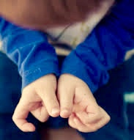
Atypical Repetitive Behaviors
Persistently repeating an action
Notes:
Although very young children generally have not developed fully-developed self-stimulatory behaviors – patterns of repetitive motion that interfere with everyday functioning – you may notice unusual or repetitive finger movements, flapping, spinning, or blinking.
Don’t forget that typical toddlers often experiment with repetitive movements as well, like blinking, clapping, or flapping their arms, but it usually doesn’t last very long. It’s always worth follow up on when we notice these patterns occurring.

Slide 25
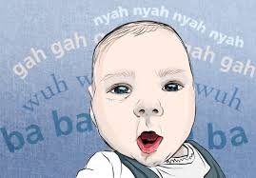
Delayed Age-Appropriate Sounds
Delayed development of babbling
Notes:
Toddlers who will go on to have autism may use a range of non-speechlike sounds – but are less likely to engage in babbling, which typically develop into more speechlike vocal patterns
Swanson, M. R., Shen, M. D., Wolff, J. J., Boyd, B., Clements, M., Rehg, J., . . . Hazlett, H. C. (2018). Naturalistic language recordings reveal “hypervocal” infants at high familial risk for autism. Child Development, 89(2), e60–e73.

Slide 26
Delayed Non-Verbal Communication
Neutral facial expressions
Reduced efforts to gain the attention of another
Reduced use of gestures to share attention
Notes:
Because we don’t yet expect young toddlers to use a lot of words, we may miss the fact that they are not using non-verbal communication to initiate shared attention. They may also have a “serious” or neutral facial affect a lot of the time, as they are not using facial expressions to attract the social attention of others as often as typically-developing toddlers.
Other early indications that a young child may have autism:
Does not imitate your gestures, expressions, sounds
Does not play simple interactive games like pat-a-cake by 12 months of age
Uses few or no gestures by 12 months of age (e.g., does not wave goodbye)
Does not share interests with others (e.g., shows you an object that he or she likes by 15 months of age
Does not point or look at what you point to by 18 months of age
Does not notice when others are hurt or sad by 24 months of age
Does not pretend in play (e.g., does not pretend to “feed” a doll by 30 months of age)
Shows little interest in peers
Has trouble understanding other people’s feelings or talking about own feelings at 36 months of age or older
Does not play games with turn taking by 60 months of age

Slide 27
Decreased Attention to Faces
More interested in objects than people
Difficult to sustain face-to-face interactions
Notes:
Most importantly, toddlers who are at-risk for or who have autism spend a lot less time looking at faces. They are much more likely to engage with objects and non-social sensory stimuli like light or movement in the environment. When caregivers try to engage them, they most often leave the interaction and even the area where the caregiver is. They do this not because they don’t like their caregiver, but because the need to manage incoming social stimuli in a way that keeps them comfortable.
Important to understand:
Humans naturally attend to face – it is a survival mechanism! But after the first 6 weeks, the reflex that all infants are born with to look at faces recedes and those infants that go on to receive a diagnosis of autism begin to prefer non-social stimuli.

Slide 28
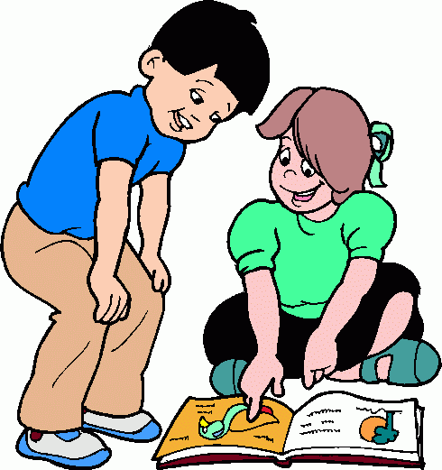
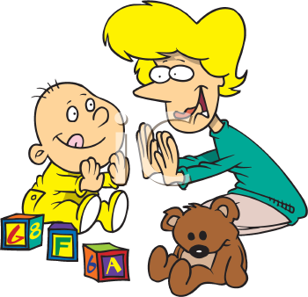
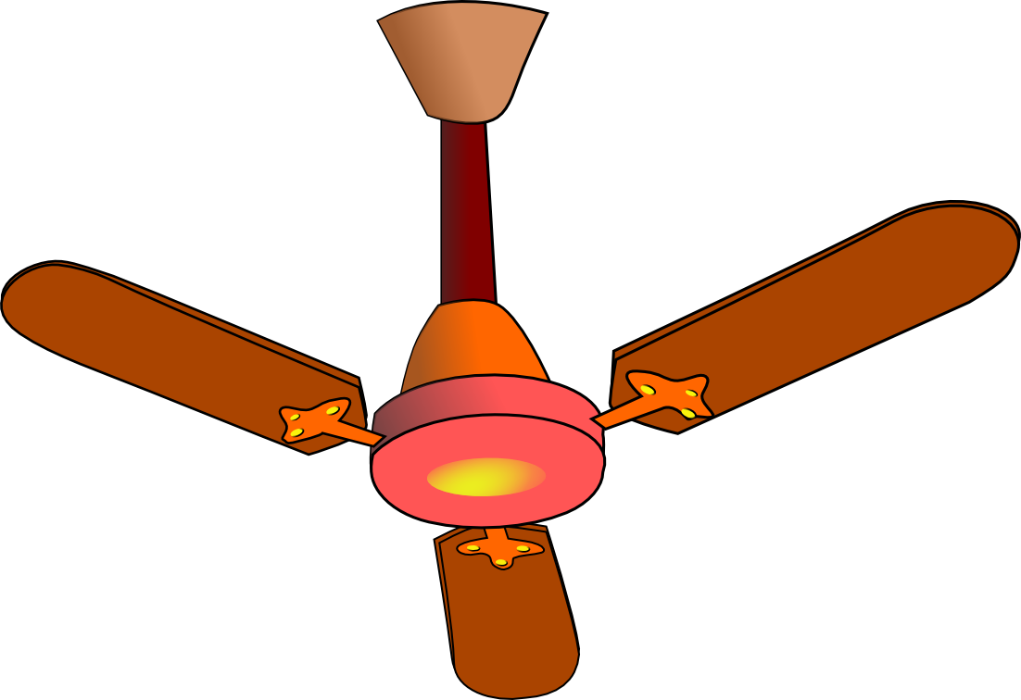
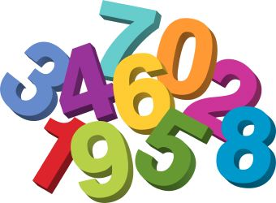
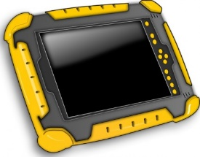
Differing Developmental Trajectories
Acquiring expertise about the social world
Acquiring expertise about the physical world
Adapted from
Ami Klin, 2015
Notes:
This graphic, adapted from a talk given by Ami Klin, shows us how typical children learn about the world over time through interactions with others – they learn a lot about how their behaviors influence others, and about how the behavior of others influences them. They learn a lot about objects as well, by sharing attention to objects with others.
Children with autism are learning too! They spend a great deal of time learning about the physical world, and become experts about how things that interest them work, sometimes to very complex degree. Most of what they learn about objects is in the context of solitary play.
While both children have learned a lot from what they have been engaging with, the children who have acquired knowledge through a social lens have learned through the more knowledgeable others in their worlds, and from peers – about what they need to know to be an included and functional member of the community.
Children with autism are experts too, even if they are experts about topics that no one else can understand, at times (for example, a child that is non-verbal but spend hours and hours studying ant colonies) – or they may be experts in things that the world values, like music, letters, numbers, and how things are built and dissembled, for instance.
Whatever the unique characteristics of a child with autism might be, our goal to support young children with autism is to help them learn to be comfortable in a social world as much as possible, so they have the best chance for participation and inclusion in their own communities, and where the special abilities they have can be most optimally shared.

Slide 29
ASD: From Screening to Diagnosis
There are no medical tests for diagnosing autism
When parents become concerned about developmental delays in children, they should consult a physician and request an EI evaluation, which is available at no cost in all states
(Bauminger-Zviely et al., 2014)
Notes:
A physician can rule out various potential medical causes, such as hearing problems.
Before a child can be diagnosed, the child should be evaluated by an autism specialist such as a psychologist, psychiatrist, pediatric neurologist, or developmental pediatrician who specializes in diagnosing and treating children with ASD.

Slide 30
Six Components of a Diagnostic Evaluation for Autism
Best practice guidelines identify the following six components:
Parent or caregiver interview
Review of relevant medical, psychological, and/or school records
Cognitive/developmental assessment
Direct play observation
Measurement of adaptive functioning
Comprehensive medical examination
Notes:
When we are engaging in assessment for the purpose of a diagnosis of autism, the following components must always be present:

Slide 31
ASD Diagnostic Criteria
ASD diagnostic criteria are described by the American Psychiatric Association (APA) in its Diagnostic & Statistical Manual of Mental Disorders (DSM-V)
Activity: Explore the DSM diagnostic criteria here at the Autism Speaks website
Notes:
Qualified professionals provide these diagnoses when symptoms of ASD (social interaction and social communication, and repetitive behaviors) are present in ranges that are inappropriate for the child’s age and developmental level. ASD is diagnosed when all these symptoms are present to some degree.
Sources:
https://www.autismspeaks.org/autism-diagnosis-criteria-dsm-5

Slide 32
ASD Specification of Severity
Qualified professionals use information gathered during the diagnostic assessment to indicate the level of support an individual with ASD requires:
Level 1 Requiring Support
Level 2 Requiring Substantial Support
Level 3 Requiring Very Substantial Support.
Notes:
A diagnosis also includes a specification of severity, list here as it appears in the DSM-5.

Slide 33
DSM-V ASD Diagnostic Criteria: Communication Area
Definition: Persistent reductions in social communication and social interaction across multiple contexts including:
Social-emotional reciprocity
Nonverbal communicative behaviors used for social interaction
Developing, maintaining, and understanding relationships
(APA., 2013)
Notes:
Here are the diagnostic criteria we consider in the area of communication:
Reductions in social-emotional reciprocity, ranging, for example, from abnormal social approach and failure of normal back-and-forth conversation; to reduced sharing of interests, emotions, or affect; to failure to initiate or respond to social interactions.
Reductions in nonverbal communicative behaviors used for social interaction, ranging, for example, from poorly integrated verbal and nonverbal communication; to abnormalities in eye contact and body language or deficits in understanding and use of gestures; to a total lack of facial expressions and nonverbal communication
Reductions in developing, maintaining, and understand relationships, ranging, for example, from difficulties adjusting behavior to suit various social contexts; to difficulties in sharing imaginative play or in making friends; to absence of interest in peers.
Discuss these examples:
Child shows little interest in making friends
Child initiates interactions only to have immediate needs met (e.g., to get food or preferred toy)
Lack of eye contact
Absent or limited gestures, or atypical gestures (e.g., using someone else’s hand as a tool to open the refrigerator)

Slide 34
Activity: Video Observation of Social Communication Differences
Autism Navigator – Social-Emotional Reciprocity
Initiating or Responding to Social Interaction
Notes:
Facilitator – create a log in on the Autism Navigator Home Page - https://autismnavigator.com/
Then, log in and click on Family Resources - https://autismnavigator.com/family-resources/ and access on the Autism Navigator ASD Video Glossary by clicking on the “GET STARTED” button
There you will see the option to open the ASD Video Glossary – hit the OPEN VIDEO GLOSSARY Button
On the left menu, click on “Social Communication and Social Interaction to view side-by-side examples of social communication skills in typically-developing toddlers and those who have ASD
View the first example which shows differences in social-emotional reciprocity: https://resources.autismnavigator.com/asdglossary/#/section/9/initiateInteraction
Play the example of the typical child first, and ask the group what they noticed about how he was engaging in that interaction (alternating eye gaze, positive facial expression, pointing, asking for help when he needed it, for example).
Play the second clip of the child at-risk for autism and notice the differences in the way he engaged (did not alternate gaze, interacted with the bottle with a focus on how it moved rather than showing interest in the activity of bubble-blowing, neutral affect, no bids to share attention to to help him open it. Ask how the fact that this child does not use clear bids to share attention may be confusing for his mother when she sties to play with him.

Slide 35
DSM-V ASD Diagnostic Criteria: Restricted/Repetitive Patterns
Restricted, repetitive patterns of behavior, interests, or activities:
Stereotyped or repetitive motor movements, use of objects, or speech
Insistence on sameness, inflexible adherence to routines, or ritualized patterns of verbal or nonverbal behavior
Highly restricted, fixated interests that are abnormal in intensity or focus
(APA., 2013)
Notes:
Lets now consider the diagnostic criteria for the area of restricted/repetitive patterns of behavior.
These criteria are described in the DSM-5 as:
Restricted, repetitive patterns of behavior, interests, or activities, as manifested by at least two of the following, currently or by history:
Stereotyped or repetitive motor movements, use of objects, or speech (e.g., simple motor stereotypes, lining up toys or flipping objects, echolalia, idiosyncratic phrases).
Insistence on sameness, inflexible adherence to routines, or ritualized patterns of verbal or nonverbal behavior (e.g., extreme distress at small changes, difficulties with transitions, rigid thinking patterns, greeting rituals, need to take same route or eat same food every day).
Highly restricted, fixated interests that are abnormal in intensity or focus (e.g., strong attachment to or preoccupation with unusual objects, excessively circumscribed or perseverative interests).
Hyper- or hypo-reactivity to sensory input or unusual interest in sensory aspects of the environment (e.g., apparent indifference to pain/temperature, adverse response to specific sounds or textures, excessive smelling or touching of objects, visual fascination with lights or movement).
Examples:
Child is consumed with a single item, idea, or person – which may shift in topic over time but persists in the singularity of focus.
Child experiences difficulty with changes in the environment
Child experiences difficulty with transitioning from one situation to another
Child may have frequent tantrums (dysregulation, uncomfortable)
Child may be aggressive or self-injurious (dysregulation, uncomfortable)

Slide 36
Activity: Observation of Restricted/Repetitive Patterns
Autism Navigator – Repetitive Behaviors and Restricted Interests
Repetitive Movements
Preoccupation with Unusual Objects
Notes:
Facilitator – create a log in on the Autism Navigator Home Page - https://autismnavigator.com/
Then, log in and click on Family Resources - https://autismnavigator.com/family-resources/ and access on the Autism Navigator ASD Video Glossary by clicking on the “GET STARTED” button
There you will see the option to open the ASD Video Glossary – hit the OPEN VIDEO GLOSSARY Button
On the left menu, click on “Repetitive Behavior and Restricted Interests” to view side-by-side examples of behavior patterns related to movements or areas of interest in typically-developing toddlers and those who have ASD
Repetitive Movements
Preoccupation with Unusual Objects
Support discussion around the differences between typical repetitive play patterns and those they noticed for the child with ASD

Slide 37
Sensory Differences
Hyper- or hypo-reactivity to sensory input or unusual interest in sensory aspects of the environment
Children may show sensory “defensiveness” to some kinds of sensory input, yet may appear not to register other forms of sensory stimuli
May show a high tolerance for pain
Notes:
Also in the DSM-5, a pattern of differences ins sensory reception and responsiveness is described in children with autism:

Slide 38
Unusual Sensory Input or Interest
Autism Navigator – Unusual Sensory Input or Interest
Over Reactive
Under Reactive
Notes:
Facilitator: Navigate to “Unusual Sensory Input or Interest” and click on the two side-by-side examples of sensory behaviors/responses of typically-developing child and a child with autism.
Support discussion about the fact that sensory differences can be complicated and include both high levels of sensory avoidance/defensiveness and sensory seeking – through visual fixations, moving parts of the body in a stereotypical way, seeking to spin around or climb up to get their needs met and to calm down.

Slide 39
Uneven Development of Skills
May demonstrate good problem-solving capacities and constructive play skills despite a lag in expressive and receptive language skills
Social communication skills that have been developing typically may begin to fade during the second year
Autism Navigator – Associated Features: Uneven Development of Skills
Notes:
Finally, as we have touched upon, there is recent evidence to support the idea that the majority of children who go on to get a diagnosis of ASD show a decline in social communication skills as they move into their second year of life – which is a critically important time for brain development as children learn in the context of social interactions.
It is very important to always follow through with evaluation for children whose parent’s are noticing even subtle lags in development during this time.

Slide 40
Some Common Diagnostic Measures
Autism Diagnosis Interview – Revised (ADI-R)
Autism Diagnostic Observation Schedule, Second Edition (ADOS-2)
Childhood Autism Rating Scale (CARS)
Skill Based Developmental Measures
Speech, Language & Social Communication Assessment

Slide 41
Autism Diagnosis Interview – Revised (ADI-R)
A clinical diagnostic instrument for assessing autism in children and adults. The instrument focuses on behavior in three main areas: reciprocal social interaction; communication and language; and restricted and repetitive, stereotyped interests and behaviors. The ADI-R is appropriate for children and adults with mental ages about 18 months and above.
(Hyman et al., 2020)

Slide 42
Autism Diagnostic Observation Schedule, Second Edition (ADOS-2)
A semi-structured, standardized assessment of social interaction, communication, play, and imaginative use of materials for individuals suspected of having ASD, including a Toddler Module and Modules 1-4, designed to be administered to different individuals according to their level of expressive language through adulthood.
(Hyman et al., 2020)
Notes:
Considered the “gold standard” of autism diagnosis, the Autism Diagnostic Observation Schedule (2nd Edition) is the most commonly used tool we see used for the diagnosis of ASD in young children, as it includes specific modules for toddlers and can be used with a wide range of developmental ages.

Slide 43
Childhood Autism Rating Scale (CARS)
Brief assessment suitable for use with any child over 2 years of age. CARS includes items drawn from five prominent systems for diagnosing autism; each item covers a particular characteristic, ability, or behavior
(Hyman et al., 2020)
Notes:
The CARS is another validated autism diagnosis instrument.

Slide 44
Skill Based Developmental Measures
Adaptive Behavior Assessments (e.g., Vineland Adaptive Behavior Scales, 3rd Edition)
Communication and Language Assessments (e.g., Clinical Evaluation of Language Fundamentals- 5th Edition; Communication and Symbolic Behavior Scales)
Fine/Gross Motor Assessments (Peabody Developmental Motor Scales, 2nd Edition)
Cognitive Assessments (e.g., Behavior Rating Inventory of Executive Function, 2nd Edition)
Notes:
The use of skill-based developmental measures can support a diagnosis of autism – but are more often used to address specific therapeutic targets as identified by the family and the rest of the IFSP or IEP team.

Slide 45
Speech, Language & Social Communication Assessment
Assessment can include:
Expressive and receptive language production and fluency,
Back-and-forth social interaction,
Pointing,
Sharing information,
Conversation,
Perspective-taking,
Understanding social situations
Notes:
Speech, language, and communication assessment by a speech language pathologist with ASD expertise, in combination with other assessments designed to evaluate social communication and joint attention as a whole - is a critical part of educational evaluation to address the child’s communication needs.
Importantly, it is critically important to ensure that Augmentative/Alternative Communication Assessment is provided for for children with very limited expressive verbal language.

Slide 46
Activity: What assessments do you use?
In your state/district, what tools are typically used to identify and evaluate young children at-risk for or who have autism?
Within the scope of your practice, what tools do you use for:
Screening?
Diagnosis?
Program planning?
Progress monitoring?
How do you collaborate with professionals across disciplines to support effective identification, referral, evaluation and planning?
Notes:
Facilitator can support discussion unique to their state and district, and encourage participants to talk about how they are or are no consistently able to communicate and collaborate across disciplines to support children at risk for or who have autism and their families

Slide 47
References
Anders, H., Hansen, J.V., Frisch, M., Melbye, M. (2019). Measles, Mumps, Rubella Vaccination and Autism: A Nationwide Cohort Study. Annals of Internal Medicine; 170:513-520. doi:10.7326/M18-2101
Bradshaw, J., McCracken, C., Pileggi, M., Brane, N., Delehanty, A., Day, T., ... & Wetherby, A. (2021). Early social communication development in infants with autism spectrum disorder. Child Development, 92(6), 2224-2234. https://doi.org/10.1111/cdev.13683
Bauminger‐Zviely, N. (2014). School‐Age Children With ASD. Handbook of Autism and Pervasive Developmental Disorders, Fourth Edition.
Dean, M., Harwood, R., & Kasari, C. (2017). The art of camouflage: Gender differences in the social behaviors of girls and boys with autism spectrum disorder. Autism, 21(6), 678–689. https://doi.org/10.1177/1362361316671845
Gardener, H., Spiegelman, D., & Buka, S. L. (2011). Perinatal and neonatal risk factors for autism: a comprehensive meta-analysis. Pediatrics, 128(2), 344–355. https://doi.org/10.1542/peds.2010-1036

Slide 48
References
Hu, A, Xiaoxu, G., Campos, P.M., Derrington, E. et al., (2020). Right Temporoparietal Junction Underlies Avoidance of Moral Transgression in Autism Spectrum Disorder, Journal of Neuroscience 24 February 2021, 41 (8) 1699-1715; DOI: 10.1523/JNEUROSCI.1237-20.2020
Hyman, S.L., Levy, S.E., Myers, S.M., & Council on Children with Disabilities, Section on Developmental and Behavioral Pediatrics (2020). Identification, evaluation, and management of children with autism spectrum disorder. Pediatrics, 145(1):e20193447 https://doi.org/10.1542/peds.2019-3447.
Klin, A., Lin, D., Gorrindo, P. et al.,(2009). Two-year-olds with autism orient to non-social contingencies rather than biological motion. Nature 459; https://doi.org/10.1038/nature07868

Slide 49
References
Ozonoff, S. & Iosif, A.M. (2019). Changing conceptualizations of regression: What prospective studies reveal about the onset of autism spectrum disorder; Neuroscience & Biobehavioral Reviews, v. 100, 296-304. ISSN: 0149-7634; DOI: 10.1016/j.neubiorev.2019.03.012
Maenner, M. J., Shaw, K. A., Baio, J., Washington, A., Patrick, M., DiRienzo, M., Christensen, D. L., Wiggins, L. D., Pettygrove, S., Andrews, J. G., Lopez, M., Hudson, A., Baroud, T., Schwenk, Y., White, T., Rosenberg, C. R., Li-Ching Lee, Harrington, R. A., Huston, M., & Hewitt, A. (2020). Prevalence of Autism Spectrum Disorder Among Children Aged 8 Years -- Autism and Developmental Disabilities Monitoring Network, 11 Sites, United States, 2016. MMWR Surveillance Summaries, 69(3/4), 1–12. https://doi.org/10.15585/mmwr.ss6904a1

Slide 50
References
Mottron, L., Dawson, M., and Soulières, I. (2009). Enhanced perception in savant syndrome: patterns, structure and creativity. Philosophical Transactions of the Royal Society B, 364: 1385-1391. https://doi.org/10.1098/rstb.2008.03333
Russell, G., Kapp, S.K., Elliott, D., Elphick, C. et al. (2019). Mapping the Autistic Advantage from the Accounts of Adults Diagnosed with Autism: A Qualitative Study, Autism in Adulthood, 4124-133. http://doi.org/10.1089/aut.2018.0035
Whitehouse AJO, Varcin KJ, Pillar S, et al. (2021). Effect of preemptive intervention on developmental outcomes among infants showing early signs of autism: a randomized clinical trial of outcomes to diagnosis. JAMA Pediatrics; 175(11):e213298. doi:10.1001/jamapediatrics.2021.3298

Slide 51
Resources
CDC: Learn the Signs, Act Early: https://www.cdc.gov/ncbddd/actearly/index.html
Autism Navigator - What are the early red flags of ASD in Toddlers: https://autismnavigator.com/what-is-autism?
Autism Speaks: Learn the Signs of Autism: https://www.autismspeaks.org/signs-autism
This is a product of the Early Childhood Personnel Center (ECPC) awarded to the University of Connecticut Center for Excellence in Developmental Disabilities and was made possible by Cooperative Agreement #H325B170008 which is funded by the U.S. Department of Education, Office of Special Education Programs. However, those contents do not necessarily represent the policy of the Department of Education, and you should not assume endorsement by the Federal Government.

